Slide 1
Addressing Ethical Challenges Using An Ethics Framework
Part of a workshop series on ethics education for Community Service Providers
Kathryn Morrison, MA PhD(c)
Ethics Fellow
Friday Jan 8th, 2020

Slide 2
Webinar Housekeeping
Everyone will be muted except the host and moderator
Ask questions through the Zoom chat box
All webinars will be recorded and posted on Regional Ethics Network website
Evaluation to follow
Next month’s speaker

Slide 4
Objectives
Identify signs of an ethical issue
Identify the value of an ethics framework in navigating challenging situations
Familiarize with the IDEA Ethics Framework
Apply the framework to an ethical case study in the community setting

Slide 5
Signs of an Ethical Issue
Caught between obligations
Conflict between staff, patients, families
Risk of harm
No guidance in law/policy
Moral distress, “yuck factor”

Slide 6
Case: When a client opts to use restraints
This case is based on a case provided by the Haldimand Norfolk Community Senior Support Services adult day program. I would like to acknowledge and thank them for this case.

Slide 7
Requester and Patient Details
Patient’s Full Name: | Robert Jones
Patient’s Age: | 62
Patient Capable? | Yes
Requester’s Full Name: | Anna Smith
Requester Role: | Supervisor
Location/Program: | Community Adult Day Program

Slide 8
Case Summary
Robert is 62 years old and lives at home, yet is a client at a local adult day program affiliated with a hospital
Robert has a degenerative muscular condition, has limited mobility, and cannot always use/control his legs
Experiences discomfort, occasionally complains about his feet sliding off of his wheelchair
Generally cognitively present, in good spirits, and engaged in the activities of the program

Slide 9
Case Summary (cont’d)
One morning, a day program volunteer notices a belt is strapped across both ankles in the wheel chair
Robert tells the volunteer that his wife put the belt on to stop his legs from sliding off the foot rests
Robert rejects requests to remove the belt or for it to be adjusted, asks that no one move or touch the belt

Slide 10
Case Summary (cont’d)
The issue was brought to the attention of the day program supervisor, Anna
Though Robert’s purpose for using the belt is for comfort by immobilizing his legs, the belt is a restraint
Anna knows that restraints are discouraged in jurisdiction (Ontario)

Slide 11
Gut Reactions to the Case?

Slide 12
How does an Ethics Framework Help?
Provides a rigorous process
Helps to pause and reflect on
Values
Perspectives
Consequences
Options
Inclusive of all stakeholders
Choice considers all factors including harms and benefits
Brings consistency and transparency

Slide 14
Use the IDEA Ethical Decision-Making Process (Community Ethics Network)
Select option, create action plan
Collaborate with stakeholders
Evaluate success, modify plan
Identify the facts
Diagnosis, history, prognosis, goals
Harms/ Benefits
Patient capability SDM, prior capable wishes
Act on the decision and evaluate
Determine the relevant ethical principles
Explore the options
Align options with legislation, professional values & obligations
Implications on equality
Values, ethical principles
Aim for compromise, reduce harm
Professional, legal obligations

Slide 15
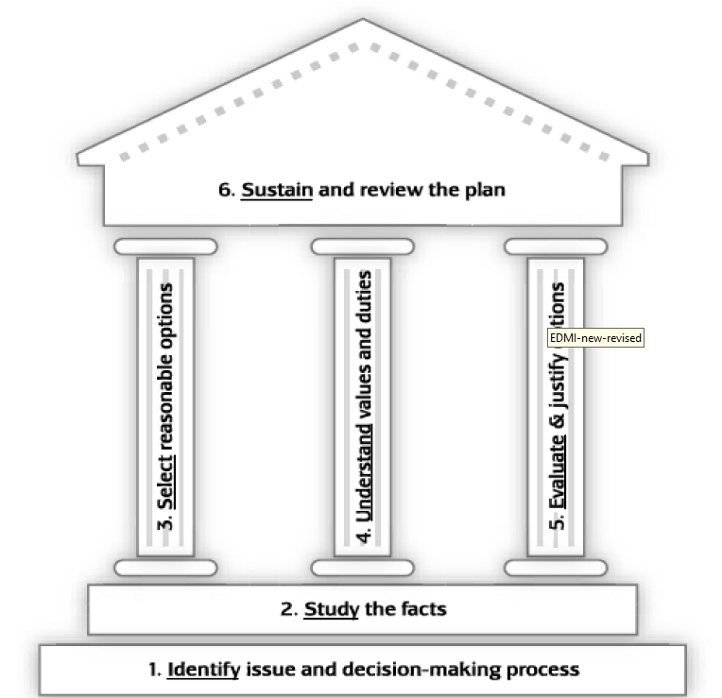
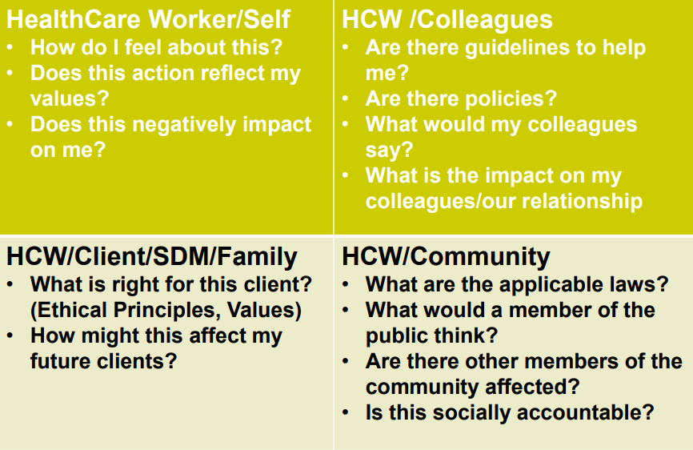
Issues Framework
(Hamilton Health Sciences)
Intention Impact Tool
Branigan, M. Intention and Impact Tool

Slide 16
Step 1: Identify the facts
What are your gut reactions?
State the question or dilemma as you currently see it: “Given ____(insert uncertainty or conflict about values), what decisions or actions are ethically justifiable?”
Determine timeline and best process for decision-making and key stakeholders.

Slide 17
Question/Dilemma: Given that Robert’s restraint poses a risk to his well-being and engages legal guidance, yet it is his wish to maintain the restraint, what decisions/actions are justifiable?
Timeline, best process: 1) Clarify legal/policy guidance on least restraint 2) Evaluate risks & benefits of the restraint 3) Evaluate options, including alternatives to restraint
Key stakeholders:
Name | Role
Robert Jones | Patient
Karen Phillips | Spouse, SDM
Dr. Simons | Family Physician
Jasmine | Day Program Volunteer
Anna | Day Program Supervisor

Slide 18
Clinical issues:
history, diagnosis, prognosis, psychosocial, capability
Patient preferences:
Patient’s long/short term goals
Contextual Features:
Patient’s background – social, cultural, religious
Family’s values
Organizational and legal issues

Slide 19
Clinical
History and Diagnosis
Robert has becker muscular dystrophy (LGMD2A) which was diagnosed in at age 16, and has resulted in progressive weakness, fatigue, and limited mobility in his legs by his late 30s. Robert has received regular physiotherapy and orthotic intervention but has had declining motor abilities, in particular challenges walking and raising his arms. He has also received regular assessment of his respiratory function.
Prognosis: degenerative, not curative
Capacity: Assessment: capable
Information retrieved from US National Institute of Health: https://rarediseases.info.nih.gov/diseases/5900/becker-muscular-dystrophy

Slide 20
Patient and Contextual
Patient Preference
Wishes to be comfortable, for his legs to be immobilized on his wheelchair
Refused requests to remove belt
Wishes to continue attending day program
Family
Robert has a wife, Carrie (61), and has no children
Carrie seems to be supportive, and is Robert’s primary caregiver
Organizational Issues
Robert’s use of the belt engages Ontario’s Patient Restraints Minimization Act (2001)
Least restraints policy, college guidelines?

Slide 21
Risks/Benefits of Restraints for Robert
Benefits | Risks (not exhaustive)
Prevents feet sliding off the foot rests | Bruises
Alleviates discomfort by immobilizing Robert’s legs | Skin irritation, injury
Conforms with Robert’s wishes | Decubitus ulcers
 | Restricted circulation
 | Stiffness, muscle atrophy
Evans L, Strumpf N. Myths about Elder Restraint. Journal of Nursing Scholarship. 22:2, 1990. Retrieved from: https://journals-scholarsportal-info.proxy.lib.uwaterloo.ca/pdf/07435150/v22i0002/124_maer.xml

Slide 22
Step 2: Determine Ethical Principles
What principles, duties and values are relevant to the case?
What are the relevant legal requirements, professional standards and policies?
Are key values, duties, principles or standards in conflict?
Can compromise be achieved?

Slide 23
Capable patients may choose to live at risk, bringing autonomy and safety (beneficence/non-maleficence) in conflict, and raising questions of justice
Living at Risk
Autonomy
Beneficence/ Nonmaleficence
Justice
Right to accept or refuse treatment in accordance with wishes, values, beliefs
Individuals should be treated fairly and without prejudice
Fiduciary duty to offer/provide treatments with expected benefit (i.e. benefits outweigh risk)
Beauchamp T, Childress J. Principles Biomedical Ethics, 5th edition. Oxford University Press. 2001.

Slide 24
Application of relevant legislation and policy to the case

Slide 26
Questions
Does Robert intend to use the restraint temporarily or long term?
Are there less restrictive ways to address the discomfort?
Are there alternatives?
Is Robert informed that the belt is a restraint, along with the risks?
Is discomfort Robert’s only reason to use the belt?
Has the hospital developed a least restraint policy? What guidance does the policy provide?

Slide 27
Step 3: Explore the Options
What are the realistic options?
look for more than two
all options should be considered seriously before eliminating any
What are the likely consequences of each?
Do the options align with relevant legislation/policy?
Consider equality

Slide 28
Options
Option 1: Hold a client-family meeting with Robert and Carrie to discuss the use of the belt, and explore options Option 2: Encourage Robert to liaise with his family physician, or LHIN services to seek a less restrictive option to manage his discomfort Option 3: Explore Robert’s request to continue to wear the belt to the ADP in terms of guidance outlined in the facilitie’s least restraints policy Option 4: Refuse to allow Robert to attend the ADP if he continues to wear the belt

Slide 29
Step 4: Act on the Decision and Evaluate
What are the possible harms/benefits of each option to various stakeholders?
Choose the option with best consequences and alignment with duties, principles and values.
State clear reasons for your choice; collaborate with stakeholders; anticipate questions and criticisms.

Slide 30
Analysis of Options
Alternative |  | Rationale
Op. 1 | ✔ | Opportunity to learn more information, ensure Robert & Carrie are aware of the issue
Op. 2 | ✔ | May yield alternative treatments or equipment Supports Robert & Carrie in a way that is client centered
Op. 3 | ✔ | Improves trust, willingness to be client centered Use of restraints unlikely to be authorized legal/policy framework, but quality of life considerations should be explored Is permitting the restraint logistically actionable?
Op. 4 | ✔ | Could impact Robert’s use of ADP service Would comply with legislative regime

Slide 31
Review the Plan
Identify how best to implement, communicate and document the decision.
Reflect on the decision and the process. What lessons could be learned for future cases?
Does this situation point to a systems or organizational cultural problem (e.g. policy gap)?

Slide 32
Implementation, Communication, Documentation
Start with 1-3, Option 4 may be necessary depending on new information arising. Next steps include:
Access least restraints policy of the hospital, determine what would comply with the policy.
Hold and document a patient-family meeting with Robert & Carrie. Ask their perception of the issue, verify Robert’s wishes. Inform them that the belt is considered a restraint. Discuss how Robert’s restraint conflicts with legal/policy requirements, and raises feasibility challenges.
Encourage Robert to explore alternatives with his family physician, Dr. Simons, and by liaising with OT for assessment of wheelchair.
Next steps responsive to any new information arising from each step for intervention.

Slide 33
Ethics Education Series for
Community Service Providers
Use “Raise Hand” feature, or type question in chat box
If we didn’t get to your question, please forward to: regionalethics@HHSC.CA

