Slide 1
USING ETHICS FRAMEWORK TO UNTANGLE DILEMMAS DURING COVID-19 PANDEMIC
Shauna Powers, RN, BScN, MSc (Public Health Practice) &
Julija Kelecevic, Regional Ethicist
Organized by Regional Ethics Network &
Haldimand War Memorial Hospital
March 8, 2021 | 12:00 - 1:00 pm

Slide 2
Webinar Housekeeping
Everyone will be muted except the host and moderator
Ask questions through the Zoom chat box
All webinars will be recorded and posted on Regional Ethics Network website
Evaluation to follow
Next month’s speaker

Slide 4
Objectives
Identify signs of an ethical issue
Identify the value of an ethics framework in navigating challenging situations
Familiarize with the HWMH Ethics Framework
Apply the framework to an ethical case study in the community setting

Slide 5
Signs of an Ethical Issue
Caught between obligations
Conflict between staff, patients, families
Risk of harm
No guidance in law/policy
Moral distress, “yuck factor”

Slide 6
Case: Visitation Policy during COVID-19 pandemic
This case represents a composite cases number of situation throughout the COVID-19 pandemic. This case is not about a single identifiable patients, rather is has been created to be used as an illustrative case for the purpose of the presentation

Slide 7
Requester and Patient Details
Patient’s Full Name: | Mary Lee
Patient’s Age: | 52
Patient Capable? | Yes, for the most part
Requester’s Full Name: | Robert Lee
Requester Role: | Husband
Location/Program: | Hospital Medical Unit

Slide 8
Case Summary
Mary is 52 years old and lives at home with her husband Robert and three children – twins Anne and Mark age 23 and daughter Emily age 18
Mary’s parents, Johnathan and Emmaline live in the same community and they are a close knot family
Mary is a high school teacher where she teaches science
Mary was diagnosed with stage IV breast cancer just 6 months ago

Slide 9
Case Summary (cont’d)
Mary had undergone all proposed therapies by the oncologist, but together they agreed to create symptom management palliative care plan
4 days ago, Mary was admitted to the local hospital because she suffered from shortness of breath, and Mary complained of increased pain
Upon the examination, the MRP has a virtual conversation with Robert, Mary’s husband, informing him that Mary’s prognosis is pretty grim

Slide 10
Case Summary (cont’d)
Robert asked is Mary is dying and MRP confirmed that he would not expect that Mary lives past two days
Although Robert was hopeful that this was just another health crisis that could be managed in hospital, he contacts Mary’s parents to informed them about sad news
He also talks with their children
Everyone wishes to visit Mary in hospital but the current policy limits number of victors to 2
Robert contact the unit manager to accommodate their family visitation and was told this is impossible
Robert finds the contact information for ethics committee and contacts asking if there is anything to be done

Slide 11
Gut Reactions to the Case?

Slide 12
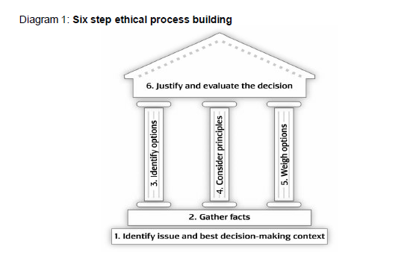

Slide 13
How does an Ethics Framework Help?
Provides a rigorous process
Helps to pause and reflect on
Principles and Values
Perspectives
Consequences
Options
Inclusive of all stakeholders
Choice considers all factors including harms and benefits
Brings consistency and transparency

Slide 14
Step 1: Identify issues and
Best decision-making context
What are your gut reactions?
State the question or dilemma as you currently see it: “Given ____(insert uncertainty or conflict about values), what decisions or actions are ethically justifiable?”
Determine timeline and best process for decision-making and key stakeholders.

Slide 15
Question/Dilemma: Given that Mary is at the end of her life and the family wishes to visit her, is granting them an exception to visitation policy ethically justifiable/defensible?
Timeline, best process: 1) Clarify legal/policy guidance on visitation policy and current IPAC and other practice standards 2) Evaluate risks & benefits of granting an exception 3) Evaluate options, including alternatives to in-person visitation
Key stakeholders: patient, her family members, team, hospital leadership

Slide 16
Step 2: Gather Facts
Clinical issues:
history, diagnosis, prognosis, psychosocial, capability
Patient preferences:
Patient’s long/short term goals
Contextual Features:
Patient’s background – social, cultural, religious
Family’s values
Organizational and legal issues

Slide 17
Step 3: Identify the Options
What are the realistic options?
look for more than two
all options should be considered seriously before eliminating any
What are the likely consequences of each?
Do the options align with relevant legislation/policy?
Consider equality
Whata re the options in this case – write in chat

Slide 18
Step 4: Consider the Principles
What principles, duties and values are relevant to the case?
What are the relevant legal requirements, professional standards and policies?
Are key values, duties, principles or standards in conflict?
Can compromise be achieved?

Slide 19
Step 5: Weight the Options
Identify pros and cons of each options
Does a single option pop as the most plausible?

Slide 20
Step 6: Justify and Evaluate the Decisions
Identify how best to implement, communicate and document the decision.
Reflect on the decision and the process. What lessons could be learned for future cases?
Does this situation point to a systems or organizational cultural problem (e.g. policy gap)?

Slide 21
Other challenges related to COVID-19 pandemic
Testing
HR deployment
Lock-in and the impact on mental health
Balancing professional and personal obligations
Working at risk, living at risk
Vaccination distribution
Resilience
WHAT IS THE ETHICAL CHALLENGE YOU FACED?

Slide 22
Use “Raise Hand” feature, or type question in chat box
If we didn’t get to your question, please forward to: regionalethics@HHSC.CA

