Slide 1
Responding to Client Inquiries About MAiD: An Update on Current Law and Practice
Presented by: Dr. Andrea Frolic, MAiD Director & Samantha Jansen, MAiD Coordinator

Slide 3
Ethics Education Series for
Community Service Providers
Use “Raise Hand” feature, or type question in chat box
If we didn’t get to your question, please forward to: regionalethics@HHSC.CA

Slide 4
Pause to reflect on personal and professional values re: MAiD and how to respond to client inquiries
Overview of the legal evolution of MAiD in Canada (2016-2021) and current law/safeguards
Understanding the MAiD process and how to access to resources for clients
What we hope you take away…

Slide 5
Check-in
What do I feel about assisted dying?
Where do my feelings come from?
What has been my experience with MAiD over the past 5 years?
What am I curious about?
What are my fears and hopes?

Slide 6
MAiD in Canada Timeline
Carter v. Canada AG
Prohibition on MAiD infringes s. 7 of Canadian Charter of Rights and Freedoms
Federal MAiD reporting requirements
Ontario Chief Coroner shift to Oversight Role
Bill C-7 becomes law, modifies safeguarding under the Criminal Code
2015
November 2018
March 17th, 2021
1993
2016
2019
March 17, 2023
Rodriguez v. BC (AG)
Prohibition on MAiD constitutional
Bill C-14
MAiD decriminalized in Canada
Truchon c. Procureur General
Reasonably foreseeable natural death requirement infringes s. 7 and s. 15 of the Canadian Charter of Rights and Freedoms
Mental illness as sole underlying condition
Notes:
Eligibility Criteria Under Bill C-14
18+ years of age and eligible for publicly funded health care services
intact decision-making capacity (no allowance for SDM, advanced directives)
Voluntary request for MAID
Informed consent to receive MAID only given after patient informed of all other means available to relieve suffering, including palliative care
Person has a “grievous and irremediable medical condition” meeting all the following criteria:
serious and incurable illness, disease or disability
in an advanced state of irreversible decline in capability
has enduring physical or psychological suffering that is intolerable to them and cannot be relieved under conditions that they consider acceptable;
their natural death has become reasonably foreseeable (RFND) – no specific prognosis/timeline

Slide 7
MAiD Eligibility Criteria Under Current Criminal CodeCurrent
18+ years of age and eligible for publicly funded health care services
intact decision-making capacity (no allowance for SDM, advanced directives)
Voluntary request
Informed consent to receive MAID only given after patient informed of all other means available to relieve suffering, including palliative care and other support services
Person has a “grievous and irremediable medical condition” meeting all the following criteria:
a) serious and incurable illness, disease or disability
b) in an advanced state of irreversible decline in capability
c) has enduring physical or psychological suffering caused by (a) or (b) that is intolerable to them and cannot be relieved under conditions that they consider acceptable

Slide 8
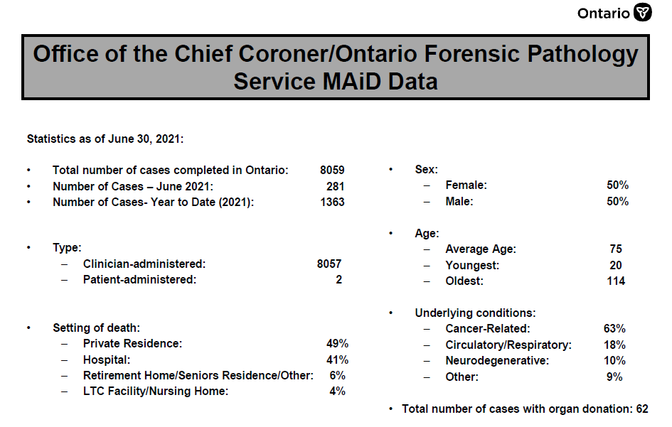

Slide 9
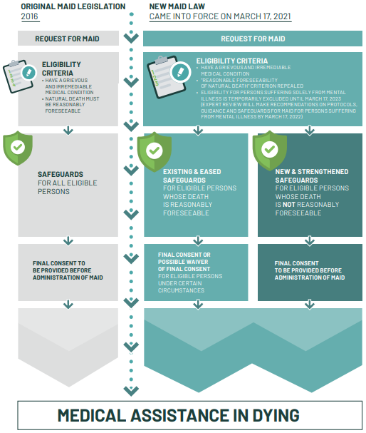
An Overview of Current MAiD Law
Expands eligibility criteria, modifies safeguards.
New populations Include:
2021: Persons without a reasonably foreseeable natural death
2023: Persons with mental illness as sole underlying condition
Allows persons with a reasonably foreseeable natural death to waive final consent
Two Streams of Safeguarding:
RFND no reflection period
No RFND: 90-day mandatory reflection period

Slide 10
Clinicians can consider interpreting “reasonably foreseeable” as meaning “reasonably predictable” from the patient’s combination of known medical conditions and potential sequelae, whilst taking other factors including age and frailty into account.
Clinicians should not employ or support rigid timeframes in their assessments of eligibility for MAiD. The law has no requirement for a prognosis having been made as to the length of time the patient has remaining. (CAMAP Practice Guide)
Ex. of RFND: Alzheimer’s with prognosis 10y (Mary Wilson, CPSBC), Spinal Stenosis (A.B, Carter), Frail elderly (as per Clinical Frailty Scale)
Reasonably Foreseeable Natural Death

Slide 11
What is still not included in the new law?
Advanced care planning
Mature Minors
SDM as decision makers– client required to have capacity for assessments

Slide 12
MAiD Process Overview
Client makes a verbal request for MAiD
Clinician provides client with the Clinician Aid A (request form)
Client signs the Clinician Aid A with 1 witness
Independent assessment completed by a physician or nurse practitioner (NP)

Slide 13
MAiD Process Overview Continued
Primary assessment completed by a physician or nurse practitioner (NP)
Client and MAiD team choose a date for the procedure
Procedure completed and coroner called

Slide 14
Case Study
Linda is a 71-year old female with progressively worse chronic pain and CHF is recently diagnosed with dementia
Begins asking her community case manager about how she can access MAiD when she is ready
She indicated to the case manager that she would like to receive MAiD when she can no longer recognize her family or when she needs help with all her activities of daily living

Slide 15
Social History
Linda worked as a teacher until she retired
Currently lives with her husband; needs support with some ADLs
Recently began receiving some homecare supports to ensure her home was safe for her
Has 3 children who are grown and living away from home
She briefly mentioned assisted dying to her children and husband. Two of her children are supportive but her one son is struggling with this life ending choice

Slide 16
Right of Conscience
Sometimes clients make choices that we disagree with; “people have a right to be wrong”
You have a right to honor your personal conscience, but NOT to impede the right of a patient to access care they want
Healthcare and Community Service Providers have a duty to honor the wishes and values of clients by supporting them to access information that will help them to make an informed choice
You can honor your own conscience while also fulfilling your duties to your client by:
Knowing the resources available for clients to explore MAiD
Talking with your team/manager about how to facilitate referrals

Slide 17
How could you support Linda?
A request for assisted dying is an invitation into the patient’s story
It is an act of trust. It is a legacy conversation.
It is a chance to listen with curiosity and nonjudgement:
Clarify the client’s values… What is most important to you? What defines a good life? What worries you?
Clarify the client’s goals… Why do you want assisted dying? What are you hoping for? What do you see as the journey ahead?
Clarify the client’s questions…Do you need more information? Do you understand your options? What are you wondering?
Clarify how the client can get their questions answered… Can you talk to your family physician?

Slide 18
Check-in
How would I feel if a client asked me about the option of MAiD?
How can I prepare for this?
What information or resources could I access to support clients to explore this choice?

Slide 19
Resources
Regional Ethics Network: www.regionalethicsnetwork.com
MAiD FAQs for patients and families
Process Algorithm
Ministry of Health MAiD Referral Service for patients/families
https://health.gov.on.ca/en/pro/programs/maid/

