Slide 1
If there’s something strange in your neighbourhood, who you gonna call?”
– The link between ethics, risk management, safety and client experience
Julija Kelecevic, Regional Ethicist
Jan 27, 2023

Slide 2



Slide 3
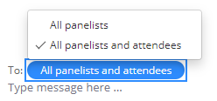

Webinar Housekeeping
Everyone will be muted except the host and moderator
Ask questions through the Zoom chat box
All webinars will be recorded and posted on Regional Ethics Network website
Evaluation to follow
Next month’s speaker

Slide 4
If there’s something strange in your neighbourhood, who you gonna call?”
– The link between ethics, risk management, safety and client experience
Julija Kelecevic, Regional Ethicist
Jan 27, 2023

Slide 5
Objectives
After this session, the participants will be able to:
Define the concepts ethics, risk management, safety and client experience
Describe the similarities and differences between these terms
Reflect on how you approach these
Discuss the organizational responses to the issues discussed

Slide 7
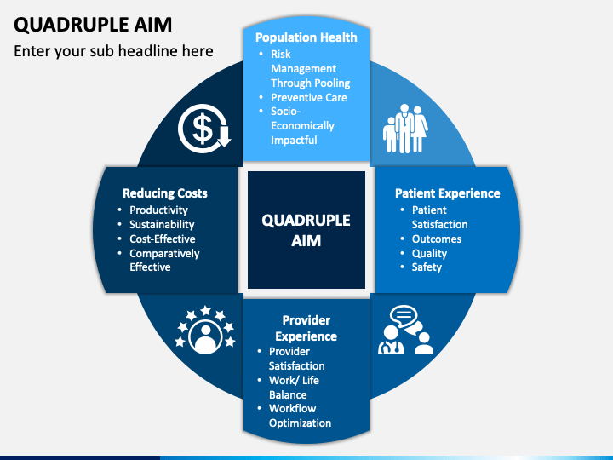
Integrated Model
https://www.sketchbubble.com/en/presentation-quadruple-aim.html

Slide 8

Case – Miriam
78-year widow, retired teacher
Lives in home
Has five children, nobody lives locally
Diabetic with neuropathy, wheelchair user
Recent diagnosis of Alzheimer’s –mild/moderate stage
Manages her ADLs with supports of HCCSS
One fall recently
Started at the adult day program two weeks ago
Children insist on using restraints when in program
They also insist she doesn’t need to eat kosher

Slide 9
Compliments
Complaints
Advisory function
Client Experience

Slide 10
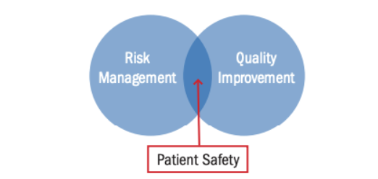
Canadian Patient Safety Institute
https://www.hiroc.com/resources/risk-notes/link-between-risk-management-patient-safety-and-quality-improvement

Slide 11
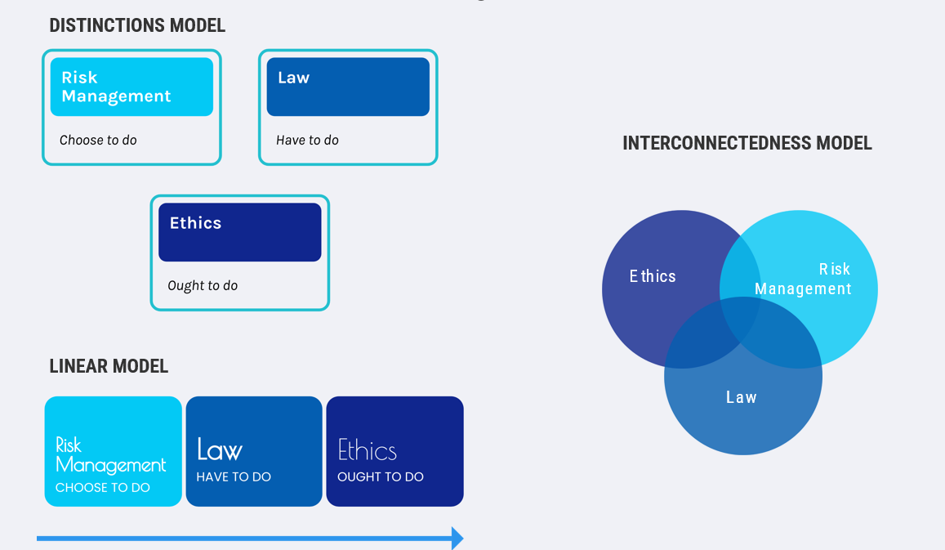

Slide 13
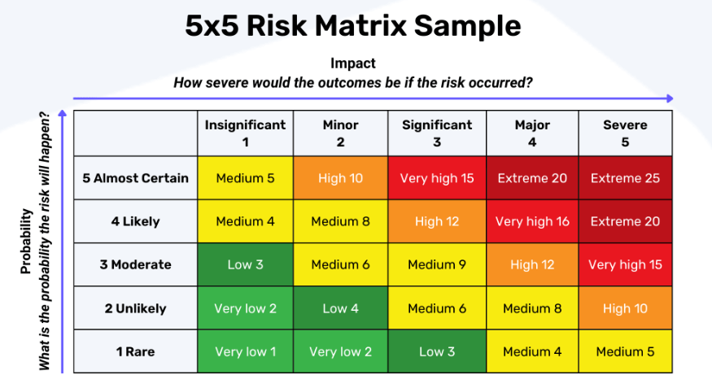
Ethics
Client Experience
Client Safety

Slide 14
Solution?
Transparency
Knowing the limitations (scope/role)
Integrated approach – balancing competing priorities; aligning with the organizational missions/vision/values, inviting client collaboration
Community of Practices

Slide 15

Ethics Education Series for
Community Service Providers
Use “Raise Hand” feature, or type question in chat box
If we didn’t get to your question, please forward to: regionalethics@HHSC.CA

