Slide 1
MODULE 1: INTRODUCTION TO ETHICS IN HEALTHCARE AND SOCIAL SERVICES

Slide 2
Module Objectives
After completing the module, you will be able to:
Define the term ethics,
Distinguish between different types of ethics (like clinical or research ethics) in healthcare and social services,
Describe differences between ethics, law and risk management,
Consider the role of ethics in your professional and personal life,
Discuss the learned concepts using the case study.

Slide 3
Before we start with the module, think about how would you identify ethics. What ideas come to your mind? What words would you use interchangeably with the term ethics?

Slide 4
Ethics
Branch of moral philosophy
What makes actions right or wrong
Moral character
What ought to be done
Values
Duties
Notes:
Branch of moral philosophy concerned with what we ought to be and do as individuals and communities. When contemplating what is ethical, people may think about what ought to be done in a specific situation. In a healthcare setting, the questions are often centered around specific patients/client or resident care. Good/Right: Admirable or permissible actions/motives Bad/Wrong: Condemned actions, motives Morals: Individual beliefs about right and wrong Values: Core beliefs, ideals, principles that guide and motivate attitudes and actions. Duties: Role-specific ethical or legal obligations Virtues: Demonstration and cultivation of values in behavior

Slide 5
Ethics in Healthcare and Social Services
Applied ethics
Study and practice of values and judgments in healthcare and social services
Subfield of bioethics
Not law, second opinion, policy, etiquette, etc.

Slide 6
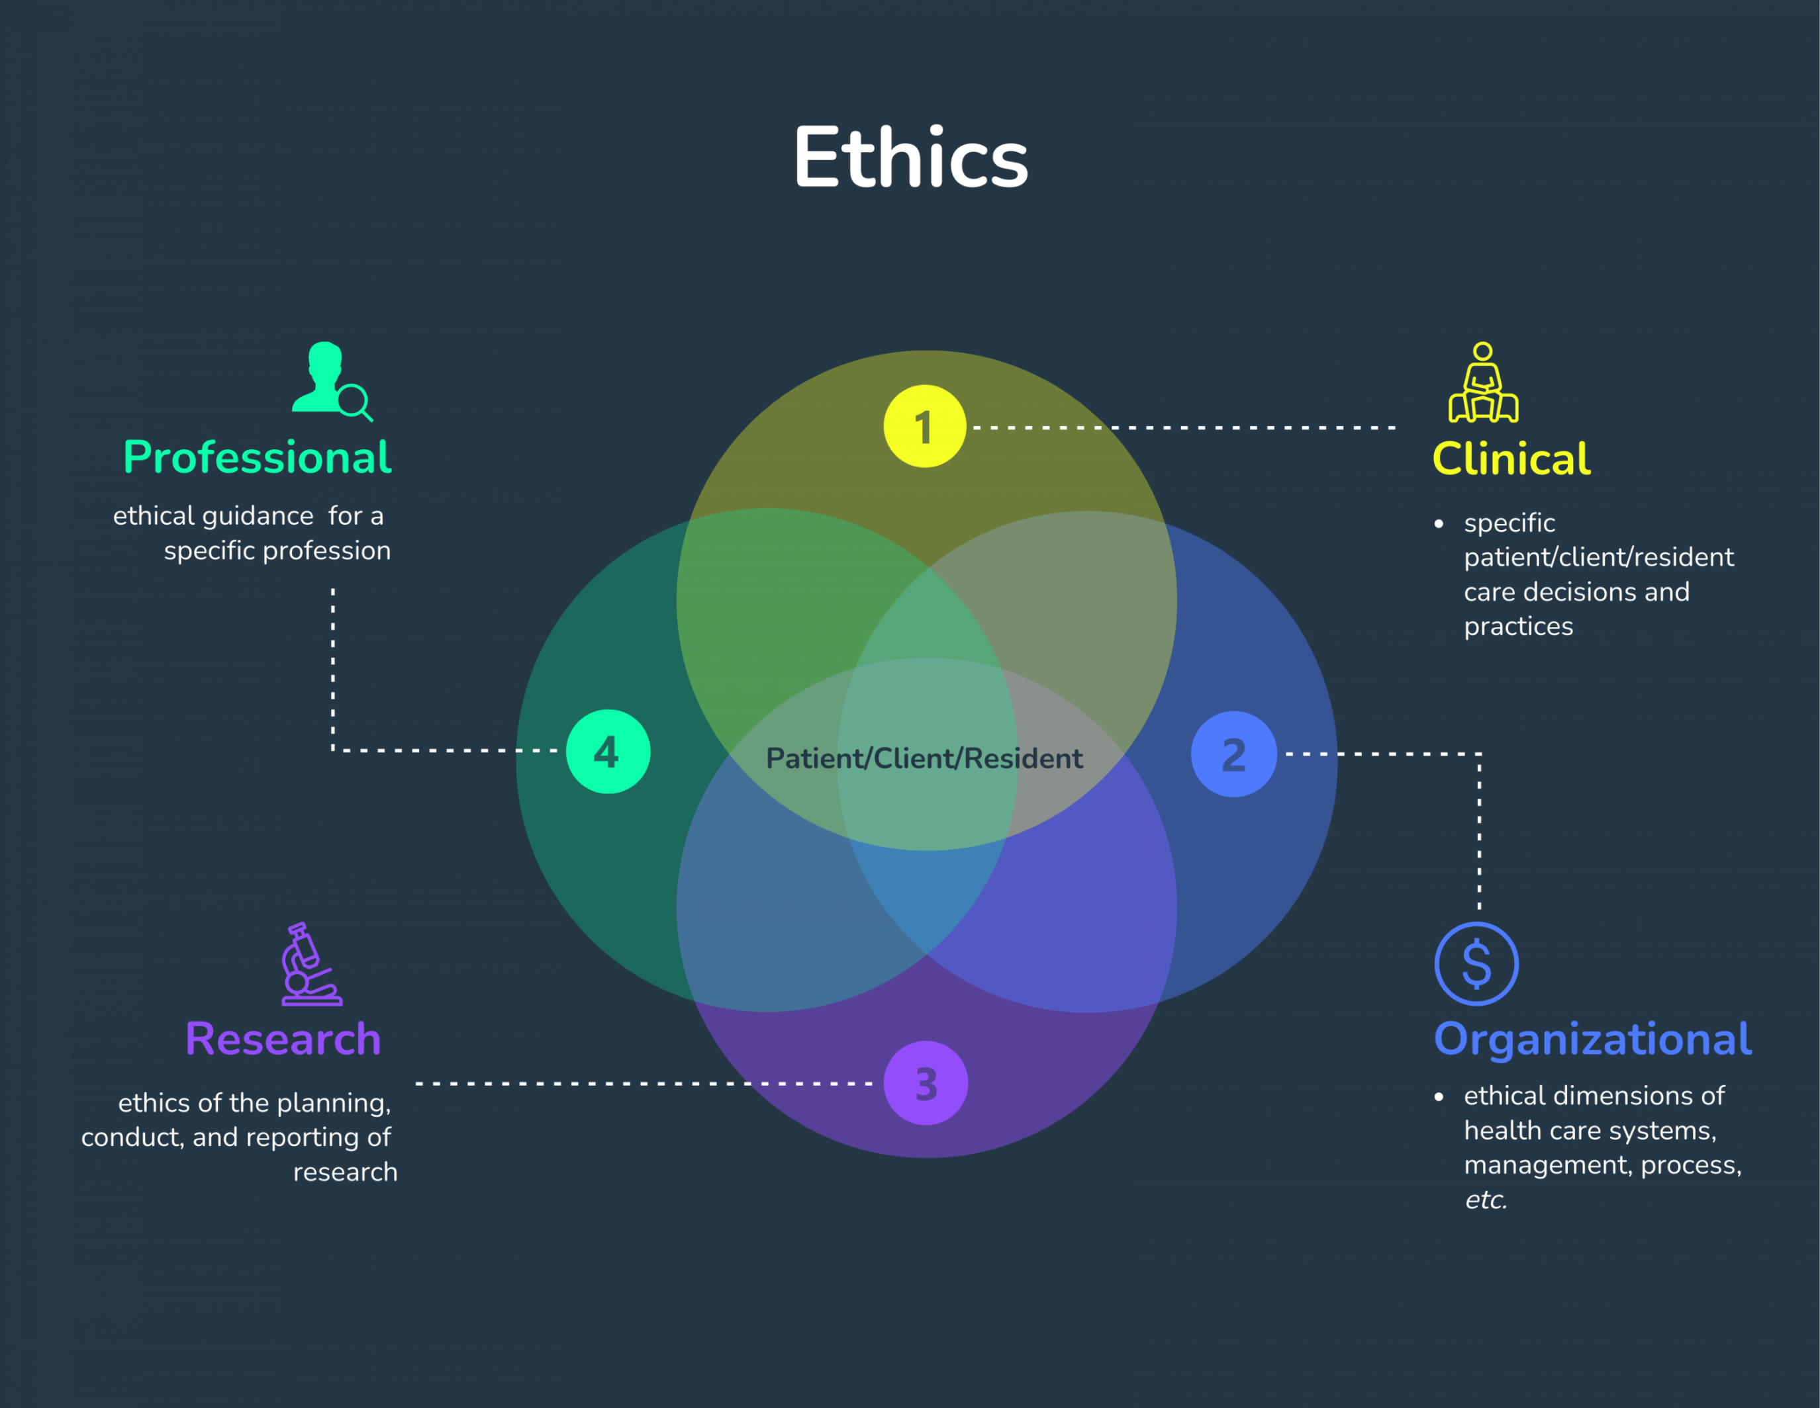

Slide 7
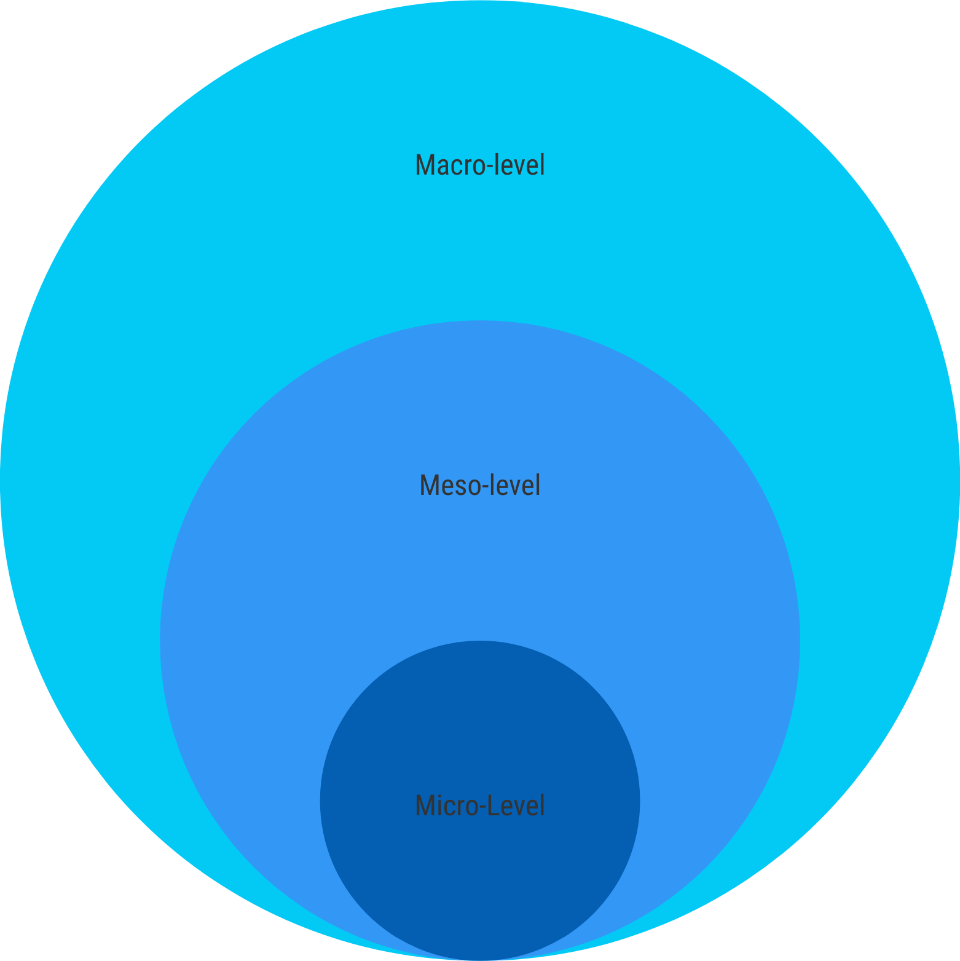
Ethics
Notes:
Macro-level ethics focus applies on a community/nation/global level. This may include considerations like International Codes/Agreements Human Rights Legislation, case law, regulation, justice system Canada Health Act Supreme Court decisions (e.g. Mortgentaler, Carter) Consent legislation Governmental structures and policies Provincial healthcare budget Drug/devise approval processes Research ethics governance Societal/Cultural Values and Norms Multiculturalism Bilingualism Gender Equality This level informs what is happening on the meso-level as well. Meso-level ethical considerations emerge where micro amid macro questions meet. What is happening in a healthcare organization occurs at this level. Although policies or regulations at this level impose some rules, it is how an organization creates its identity as a response to complex questions. Many ethical questions during COVID happened on this level, like visitation policies, allocation of PPE, prioritization of vaccines, etc. Other examples include: Balancing obligations to different stakeholders (staff vs. patients) Applying law/policy to particular circumstances Weighing good of individual vs. good of community (acute care vs. population health) Treating today’s patient vs. preparing for tomorrow’s patients (research or strategic planning) Quality vs. quantity (resource allocation) The urgency of care vs. benefit of care (waitlist) At micro- level, ethical discernment focuses on a single person. The focus may be on a patient/client or resident or healthcare provider. Individual Patient/Client: What are their healthcare goals? What are their values/beliefs? What is their context (social, economic, geographic)? Individual healthcare provider: What is the mission of my profession? What is my personal “calling”? What is my role/scope in this situation? How does my code of ethics direct me? What are my personal values, feelings, concerns?

Slide 8
What ethics questions do you encounter most frequently in your day-to-day work? Are they clinical, professional, research or organizational? Reflect on what level most of your ethical concerns occur - micro-, meso- or macro-level.

Slide 9
Here, pause the slides and go to this module's case study. Upon reading the case, reminisce on what type of ethics the healthcare providers may be worried about. What level of ethics should the stakeholders consider in this case?

Slide 10
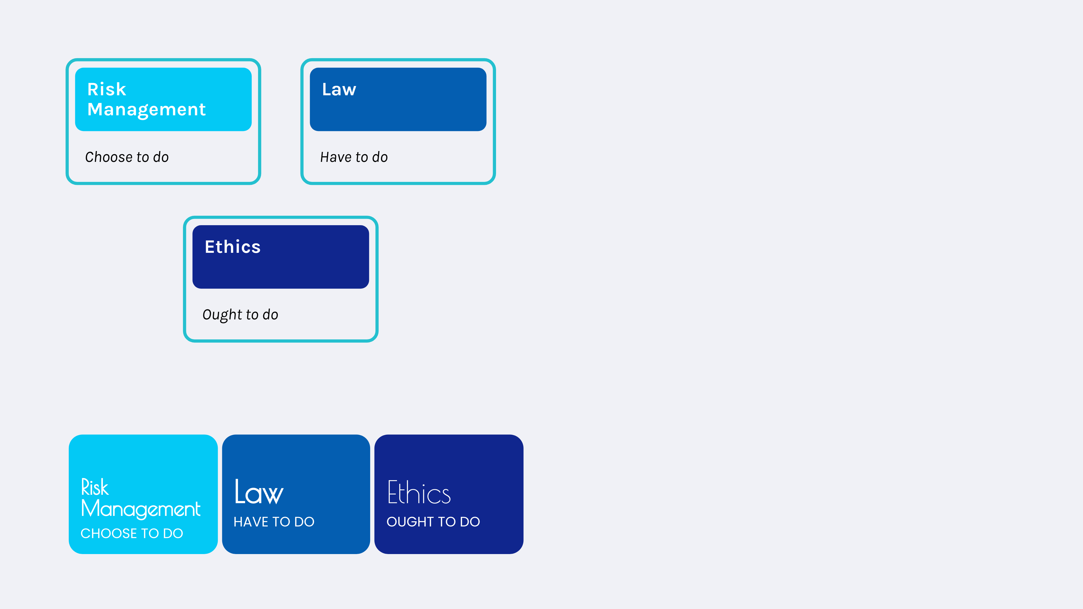
DISTINCTIONS MODEL
INTERCONNECTEDNESS MODEL
Risk
Management
Ethics
LINEAR MODEL
Law

Slide 11
Definitions
Risk Management
Law
Ethics
Notes:
Law rules of allowed conduct stemming from legislative statutes and court decisions. vary in different locales and are enforceable only in certain jurisdictions Ethics the application of values and moral rules to human activities. incorporates broad values and beliefs about correct conduct

Slide 12
Locate a copy of your professional Code of Ethics or explore the ethics guidelines of another healthcare professional. What is the focus of the document you found?

Slide 13
Before we conclude with the module, consider the role ethics plays in your professional and personal life. At this point, how comfortable are you with your knowledge and skills about ethics? Is spending time reflecting on ethical dimension of practice helping or hindering your work?

Slide 14
NEXT STEPS
If you want to learn more about the topics presented in this module, here are some suggestions:
Duthie, K., Jiwani, B., & Steele, D. (2017). Ethics and the Law. HEC forum : an interdisciplinary journal on hospitals' ethical and legal issues, 29(4), 347–358. Faden, R. R., Kass, N. E., Goodman, S. N., Pronovost, P., Tunis, S., & Beauchamp, T. L. (2013). An ethics framework for a learning health care system: a departure from traditional research ethics and clinical ethics. The Hastings Center report, Spec No, S16–S27.

