Slide 1







MODULE 10:
SUMMARY – ETHICS CASE ANALYSIS

Slide 2



Module Objectives
After completing the module, you will be able to:
    Recognize the learned concepts in the case you analyzed,
    Use ethics framework and decision-making tool to work through the case,
    Create an option that is ethically justifiable in this scenario.

Slide 3



Before you start with the last module, reflect on what you reviewed or learnt? What was the most surprising?

Slide 4

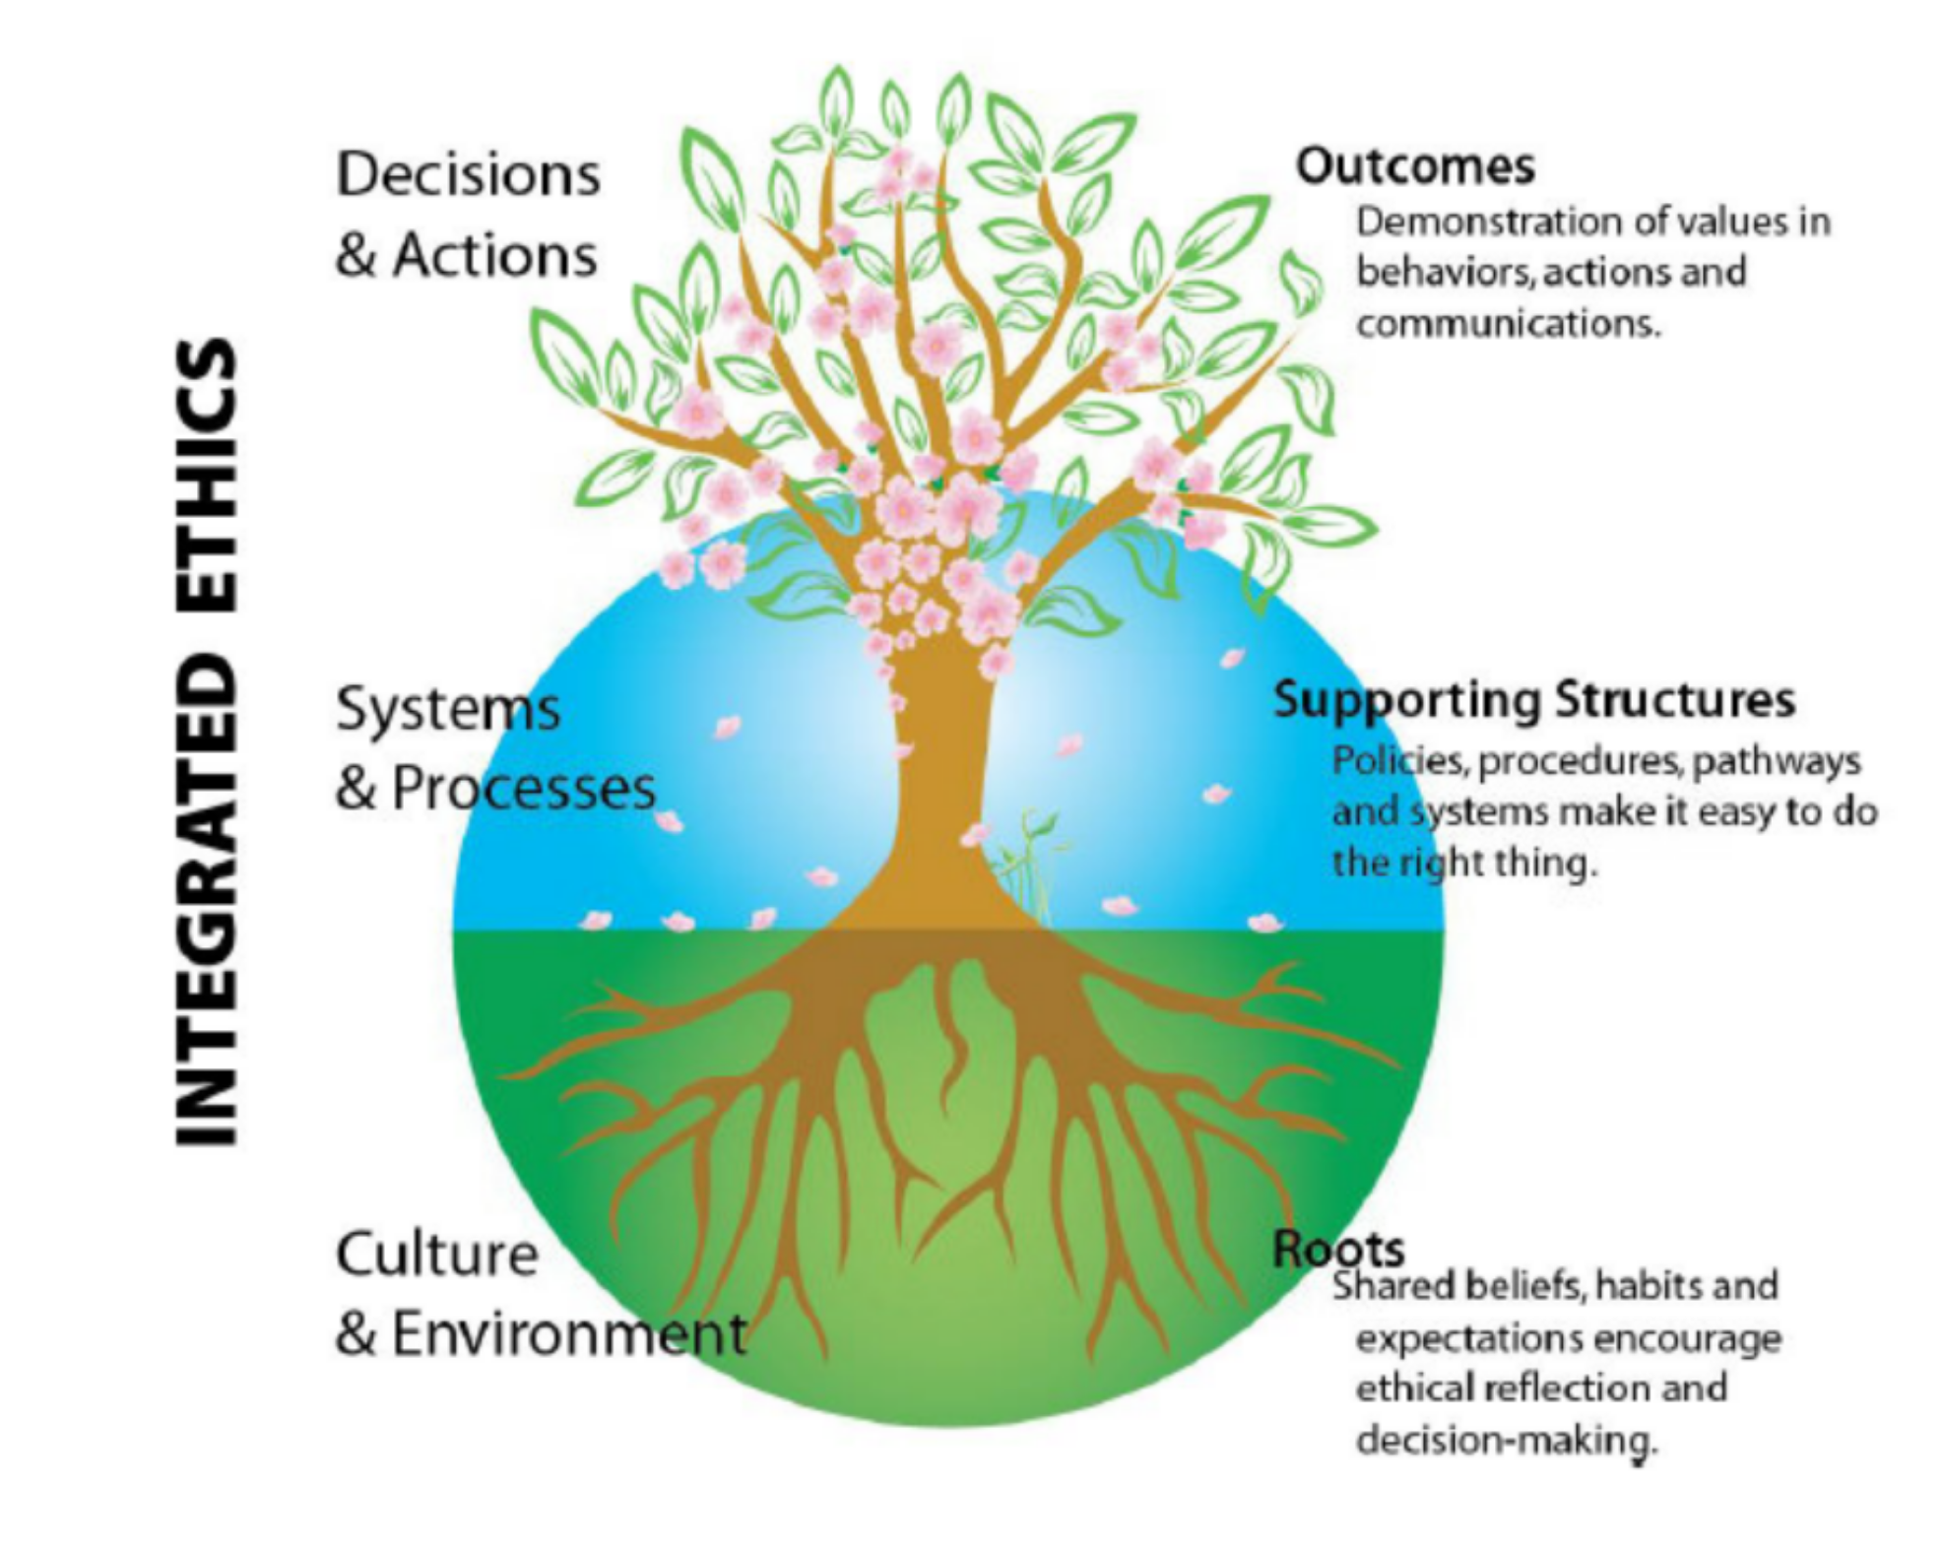
HHS Framework

Slide 5
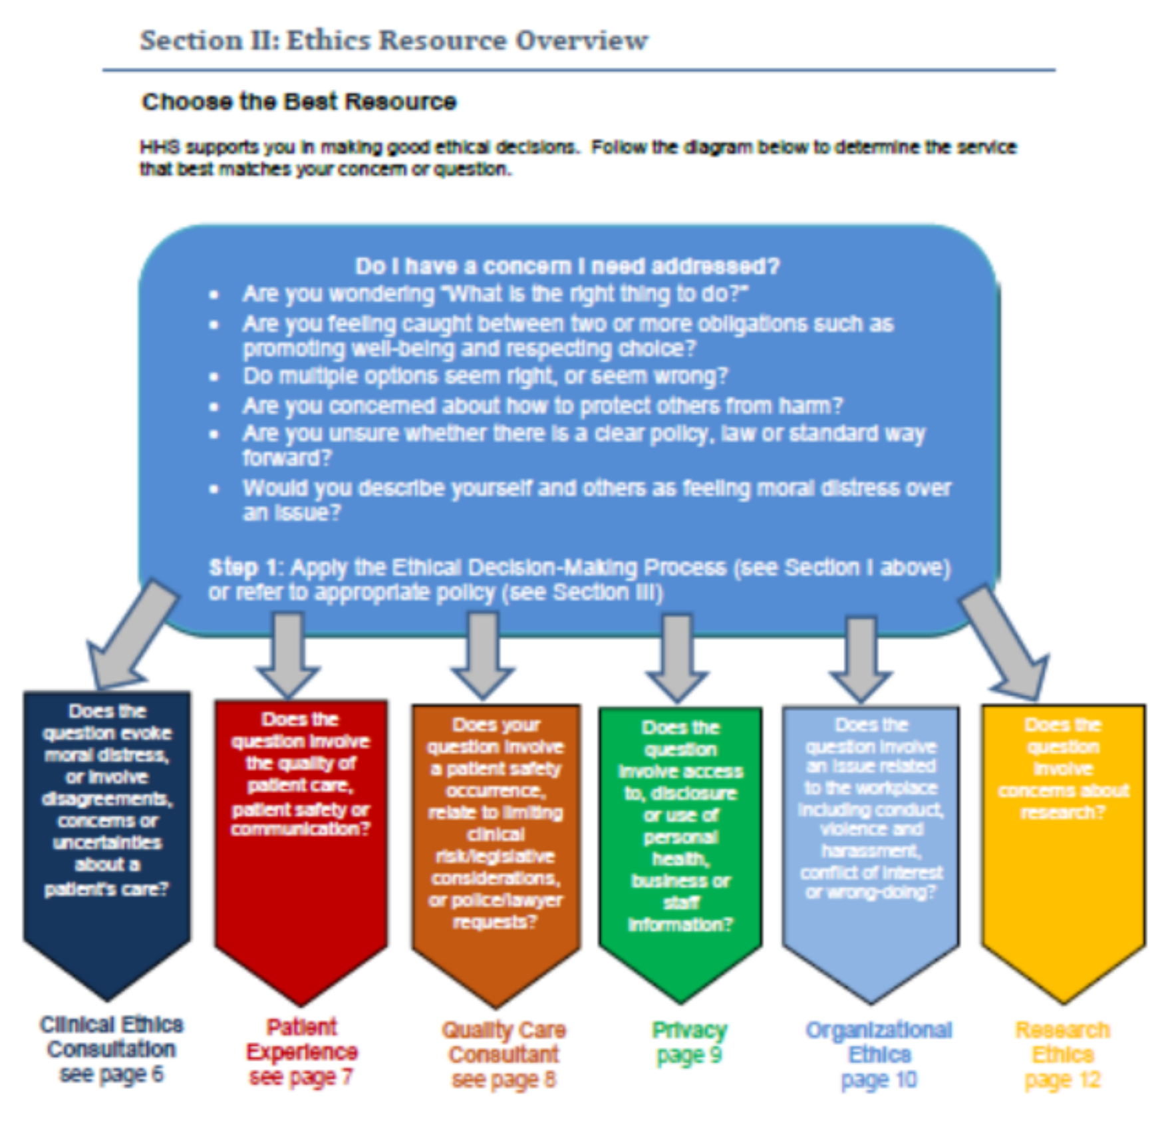
HHS Framework

Slide 6


How does Ethics Framework Help?
Provides rigorous, standardized, transparent process,
Helps us pause and reflect on values, principles, options and consequences
Calls for inclusion of all stakeholders
Considers all factors, including balance of benefits and harms

Slide 7
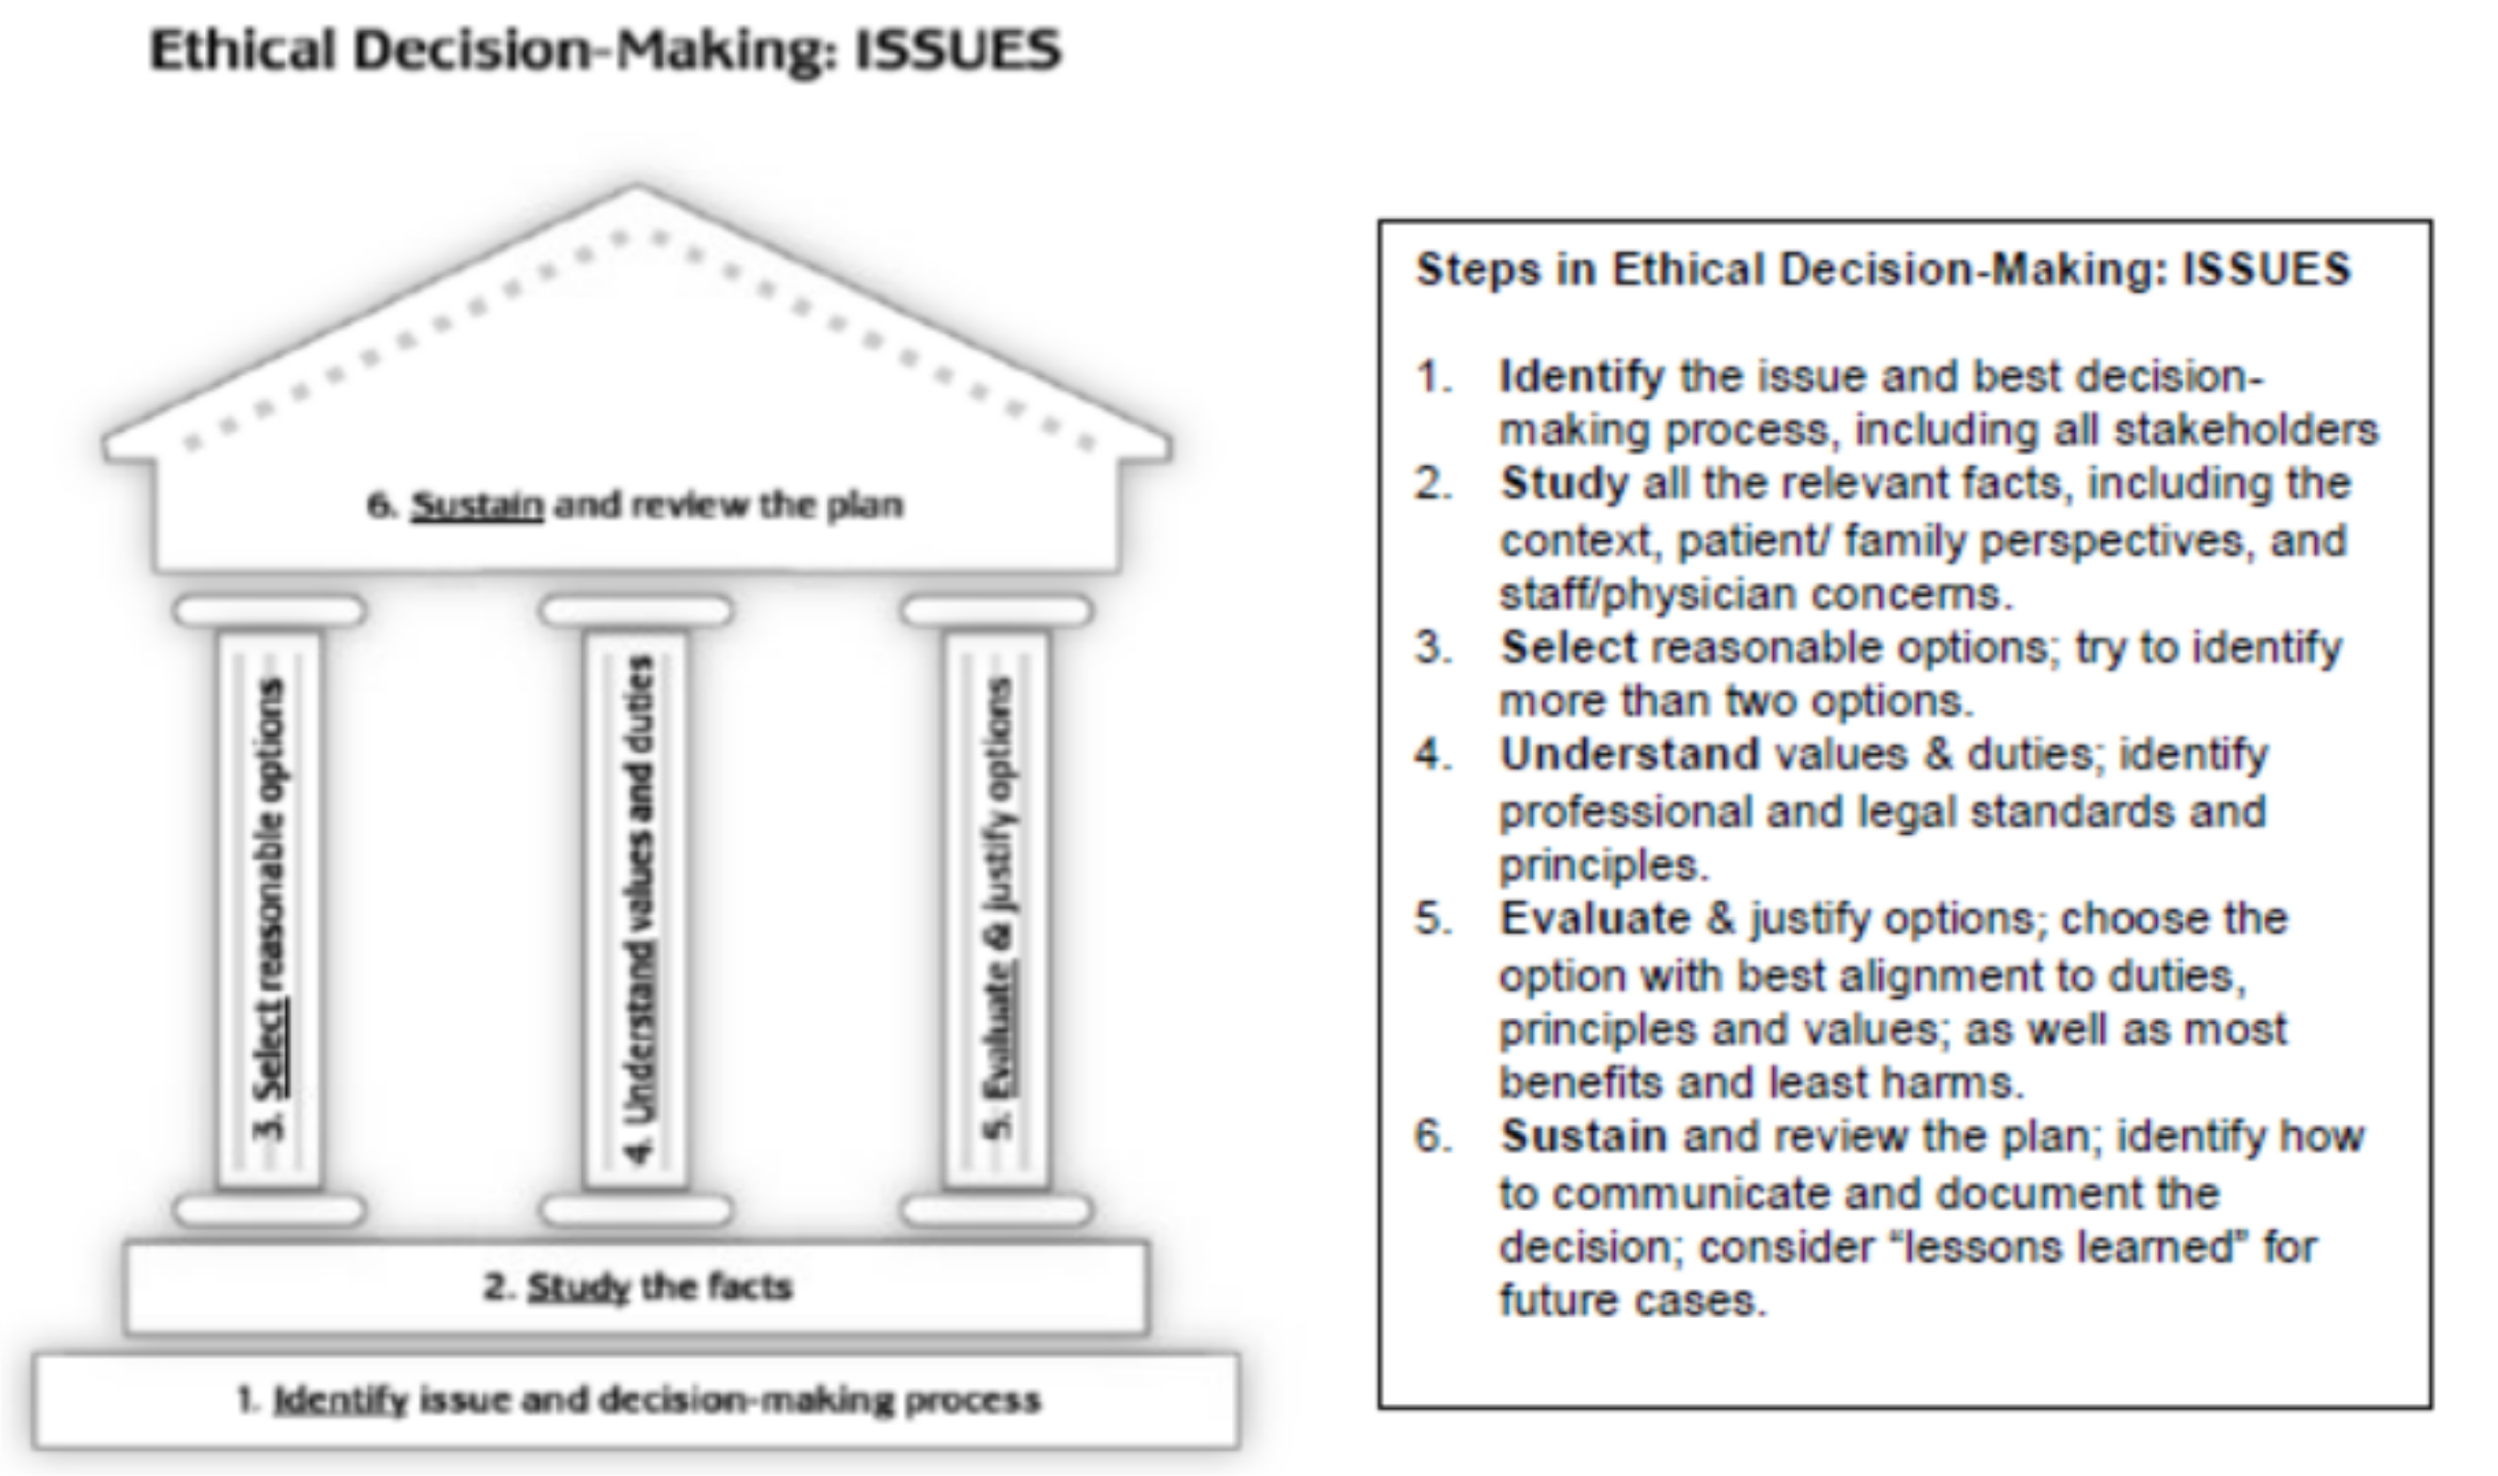
HHS Decision-Making Tool

Slide 8
Please read the case for this module. Have a copy of HHS Ethics Framework handy.

Slide 9



Step 1. Identify Issues
What was your gut reaction after reading the scenario?
In this case, what is the key conflict between staff, patient and family?
State the ethical dilemma: “Given __________ (insert uncertainty or conflict about the values), what decisions or actions may be ethically justifiable?
Determine the urgency and identify key stakeholders, and decide on the decision-making process

Slide 10
Step 2. Study Facts
Clinical issues:
    history, diagnosis, prognosis, psychosocial, capability
Patient preferences:
  Patient’s long/short term goals
  Contextual Features:
  Patient’s background – social, cultural, religious
  Family’s values
  Organizational and legal issues

Slide 11
Step 3. Select Options
Given __________ (insert uncertainty or conflict about the values), what decisions or actions may be ethically justifiable?
What are the realistic options?
Try to identify more than two options

Slide 12
Step 4. Understand Values
What principles, duties and values are relevant to the case?
What are the relevant legal requirements, professional standards and policies?
Are key values, duties, principles or standards in conflict?
Can compromise be achieved?

Slide 14
Step 5. Evaluate the Options
What are the likely consequences of each?
What are the possible harms/benefits of each option to various stakeholders?
Do the options align with relevant legislation/policies and guidelines?
Consider options seriously and equally before eliminating
Choose the option with best consequences and alignment with duties, principles and values.

Slide 15
Step 6. Sustain Plan
State clear reasons for your choice; collaborate with stakeholders; anticipate questions and criticisms.
Communication is the key!
Document the option
Address any CQI opportunities (education, change in policies, etc.)
Repeat the process, if circumstances change

Slide 16


Before you finish the series, reflect on the content learnt.
What was surprising for you?
What will you change in your practice? What suggestions do you have for us to improve this education?

Slide 17

NEXT STEPS
If you want to learn more about the ethics, connect with us using email regionalethicsnetwork@hhsc.ca .
THANK YOU!

