Slide 1
MODULE 2: STRUCTURES AND RESOURCES SUPPORTING ETHICAL DECISION-MAKING

Slide 2
Module Objectives
After completing the module, you will be able to:
Discuss structures that support ethical decision-making in an organization
Define ethics framework,
Discuss the learned concepts using the case study.

Slide 3
Before you start with the module, do you know what kind of ethics structures exist in your healthcare organization? Was it easy to locate them?

Slide 4
Ethics Supports
Organizational Governance
People
Ethics Tools

Slide 5
Organizational Structures
Mission, Vision, Values
Organizational Culture
Policies and Procedures

Slide 6
Canadian Hospital Clinical Ethics Committees
2008 study
85% of hospitals with more than 100 beds
variation in size and composition
increase in education role
less involvement in policy work
Gaudine, A., Thorne, L., LeFort, S. M., & Lamb, M. (2010). Evolution of hospital clinical ethics committees in Canada. Journal of Medical Ethics, 36(3), 132-137.

Slide 7
Ethics Structures in Ontario
2016 study
126 hospitals invited
combination of ethics committee, ethics consultants and ethicists
larger the hospital, more specialized role
regional ethics programs
Breslin, J. (2017). A Survey of Hospital Ethics Structures in Ontario. Healthcare Quarterly (Toronto, Ont.), 20(2), 27-30.

Slide 8
Ethics Tools
Ethics Frameworks Ethics Algorithms Ethics Worksheets...

Slide 9
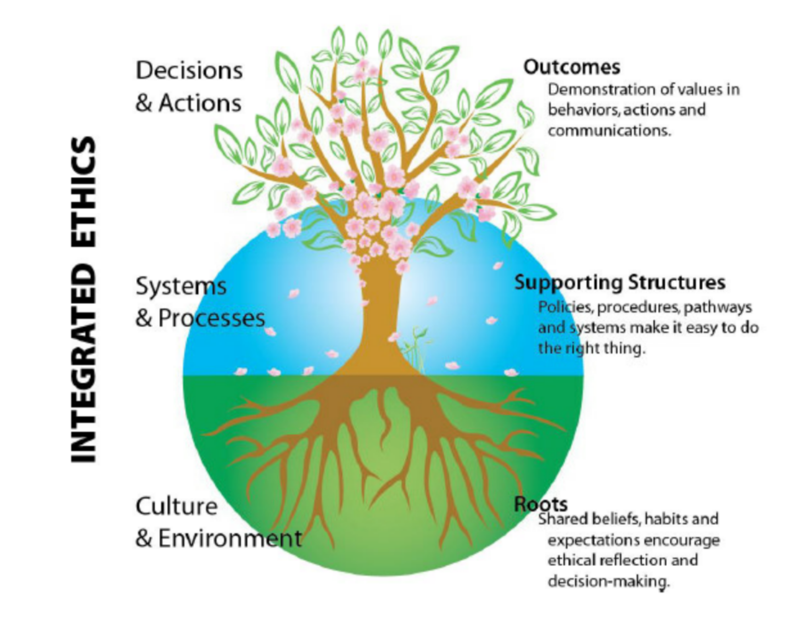
HHS Framework

Slide 10
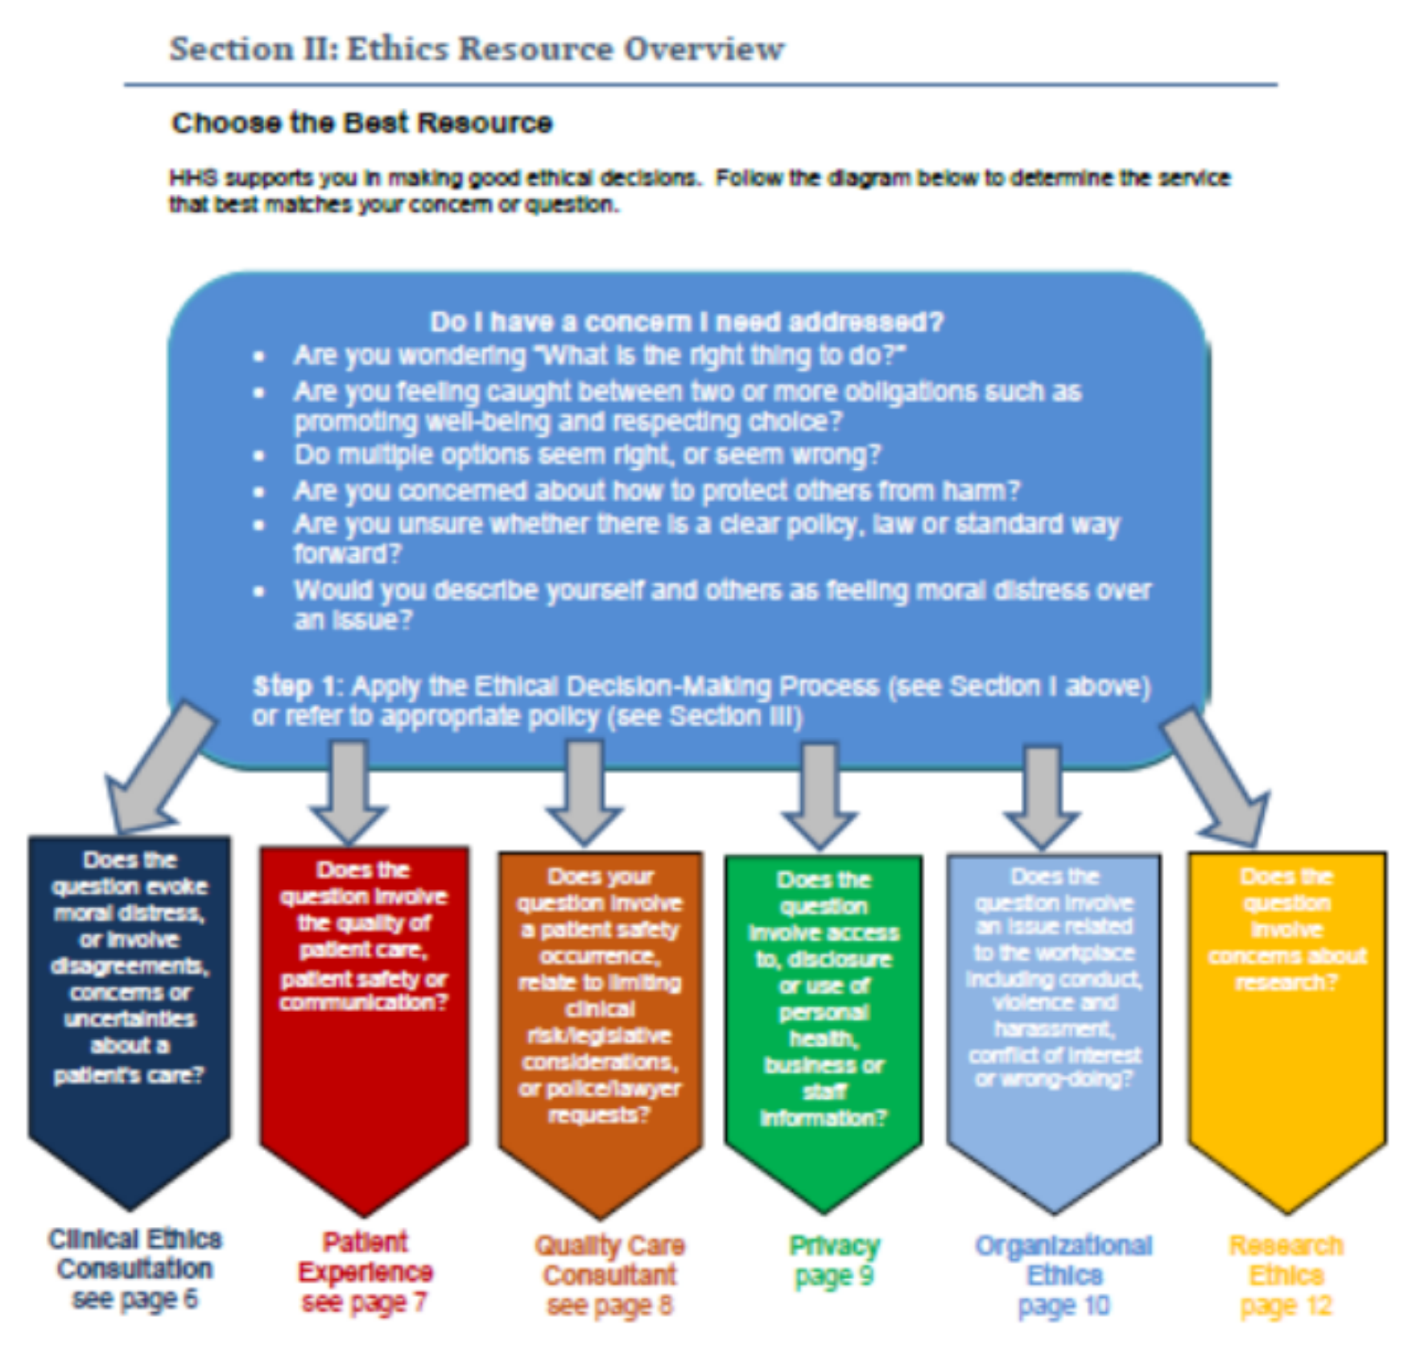
HHS Framework

Slide 11
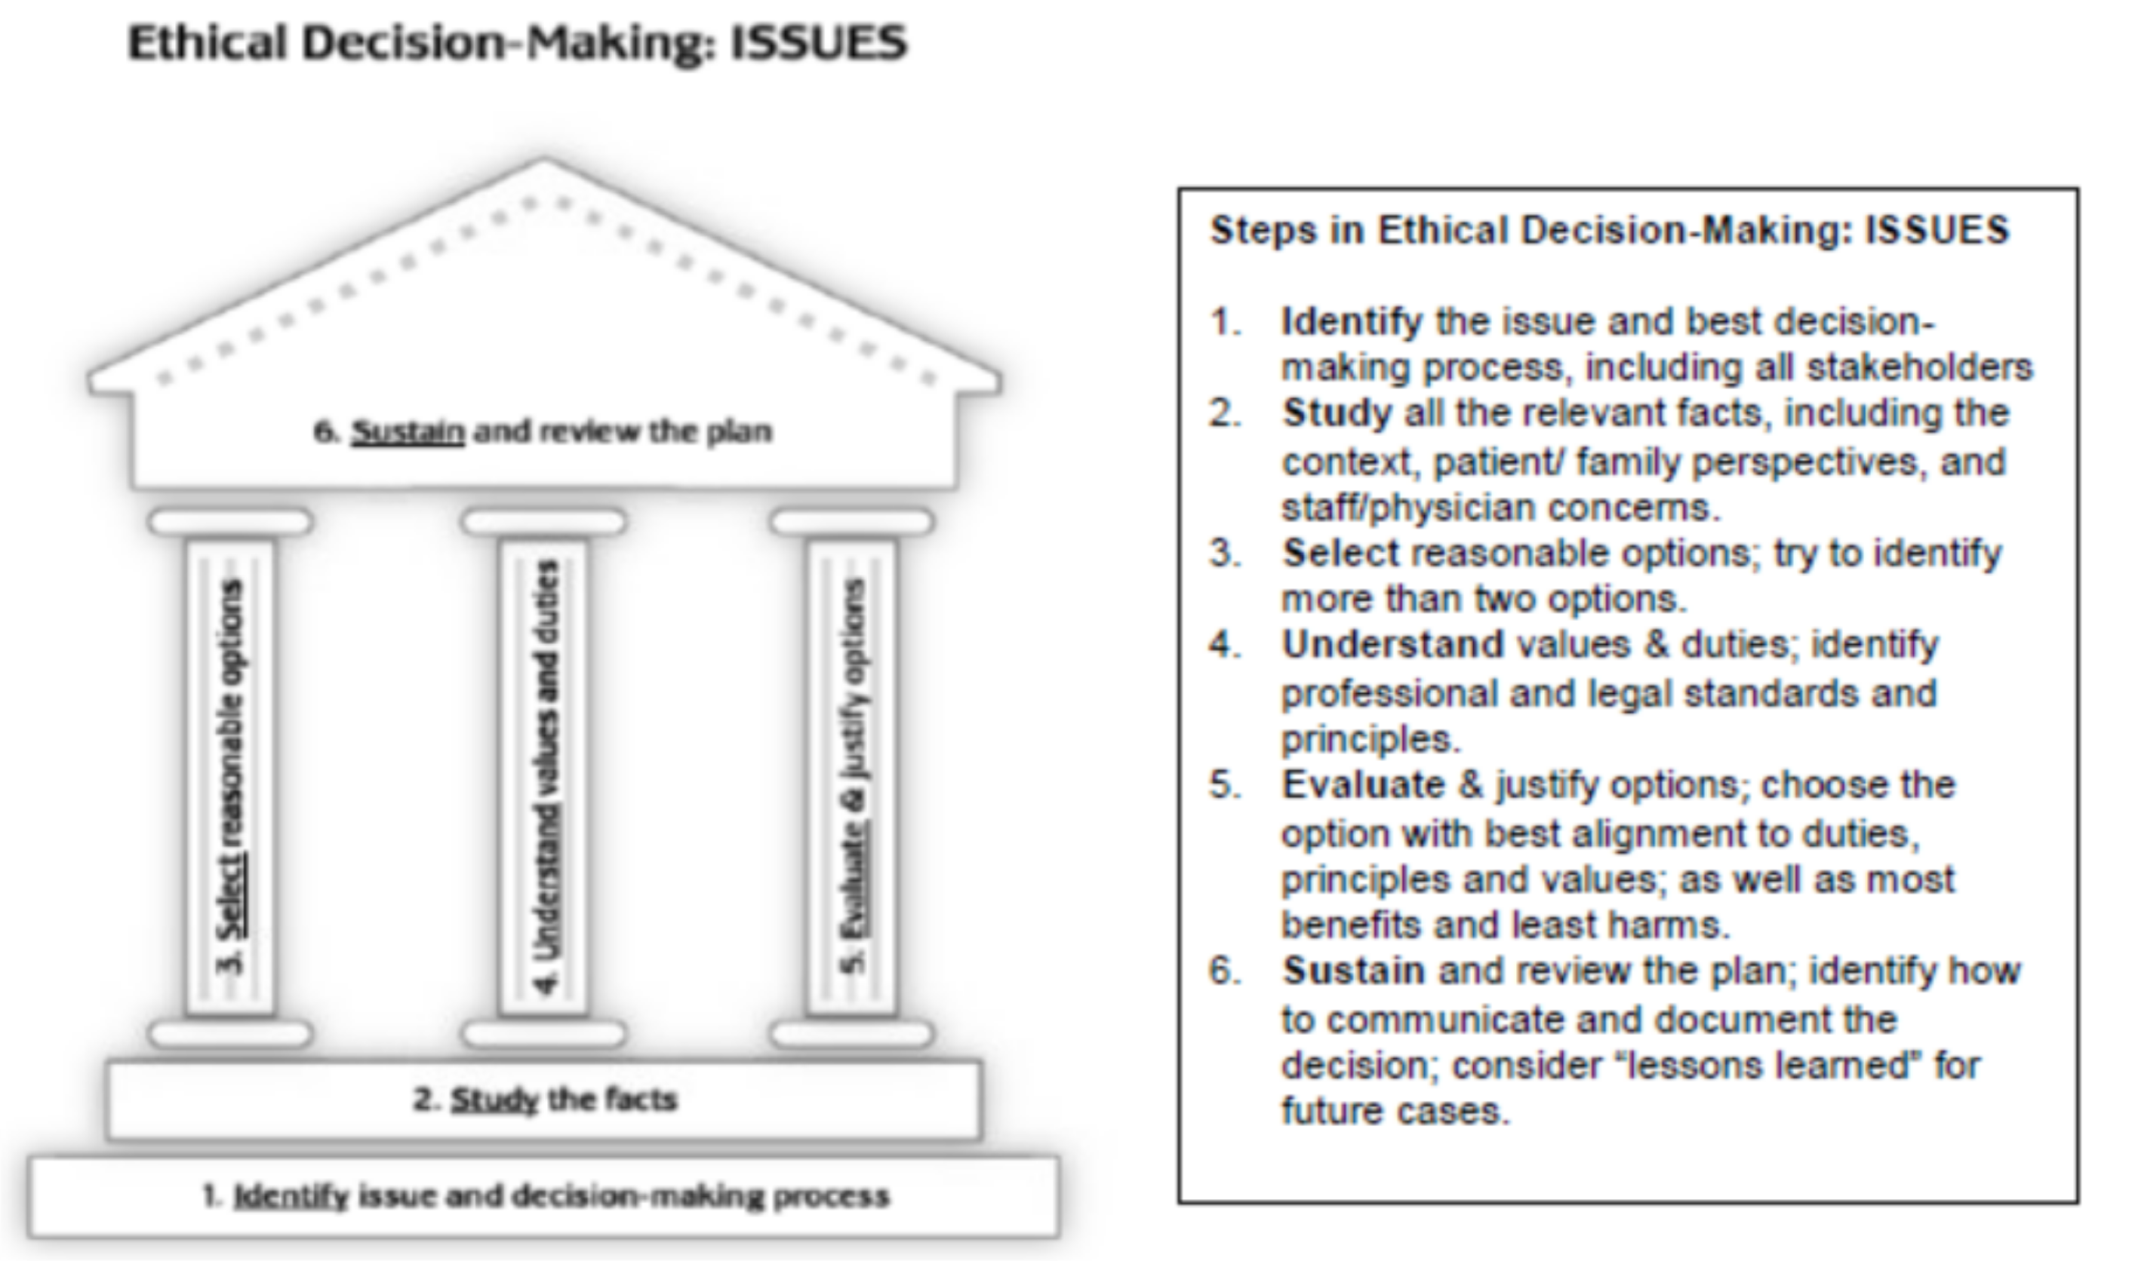
HHS Framework

Slide 12
Reflect upon how you address ethical dilemmas in your work. What approach do you use - talk with your team members, connect with your leaders, use framework or do something else?

Slide 13
Let's pause the slides now and go to this module's case study. Upon reading the case, reminisce on what kind of ethics resources would be useful for the people in this case.

Slide 14
Before you finish the module, be sure that you spend some time exploring what kind of ethics resources exist in your organization.

Slide 15
Module Summary
ethics resources should be accessible
they should be developed in collaboration
they should be evaluated

Slide 16
NEXT STEPS
If you want to learn more about the topics presented in this module, here are some suggestions :
Ehlen, J. K. (1998). Ethics and decision making in healthcare. Journal of Healthcare Management, 43(3), 219-221. Pavlish, C., Brown-Saltzman, K., Fine, A., & Jakel, P. (2013). Making the call: a proactive ethics framework. HEC Forum 25 (3): 269-283. Sullivan, W. F., Björne, P., Heng, J., & Northway, R. (2022). Ethics framework and recommendations to support capabilities of people with intellectual and developmental disabilities during pandemics. Journal of Policy and Practice in Intellectual Disabilities, 19(1), 116-124.

