Slide 1
MODULE 3: ETHICAL DECISION-MAKING AND REFLECTION

Slide 2
Module Objectives
After completing the module, you will be able to:
Identify what an ethical dilemma is,
Discuss how ethical decision-making happens in healthcare or social services
Describe what ethical reflection is,
Discuss the learned concepts using the case study.

Slide 3
Before you start with the module, think about how you make difficult decisions in your personal life. Is decision-making different if it is in a professional context? Do you use your instincts or are you more process-oriented?

Slide 4
Ethics Dilemma
The "yuck factor": an intuition that something isn't right, or a feeling of moral angst
Ethical dilemma (Right vs. Right or Wrong vs. Wrong): Two or more principles apply to a situation, but these values support diverging courses of action. How do you choose? (i.e., it is right to honour patient wishes, and it is also right to protect patients from harm)
Moral Distress: you know the "right" thing to do in a situation, but various constraints make doing the right thing difficult.
Ethical Uncertainty: Conflict or uncertainty regarding a patient's quality of life, treatment plan or goals of care

Slide 5
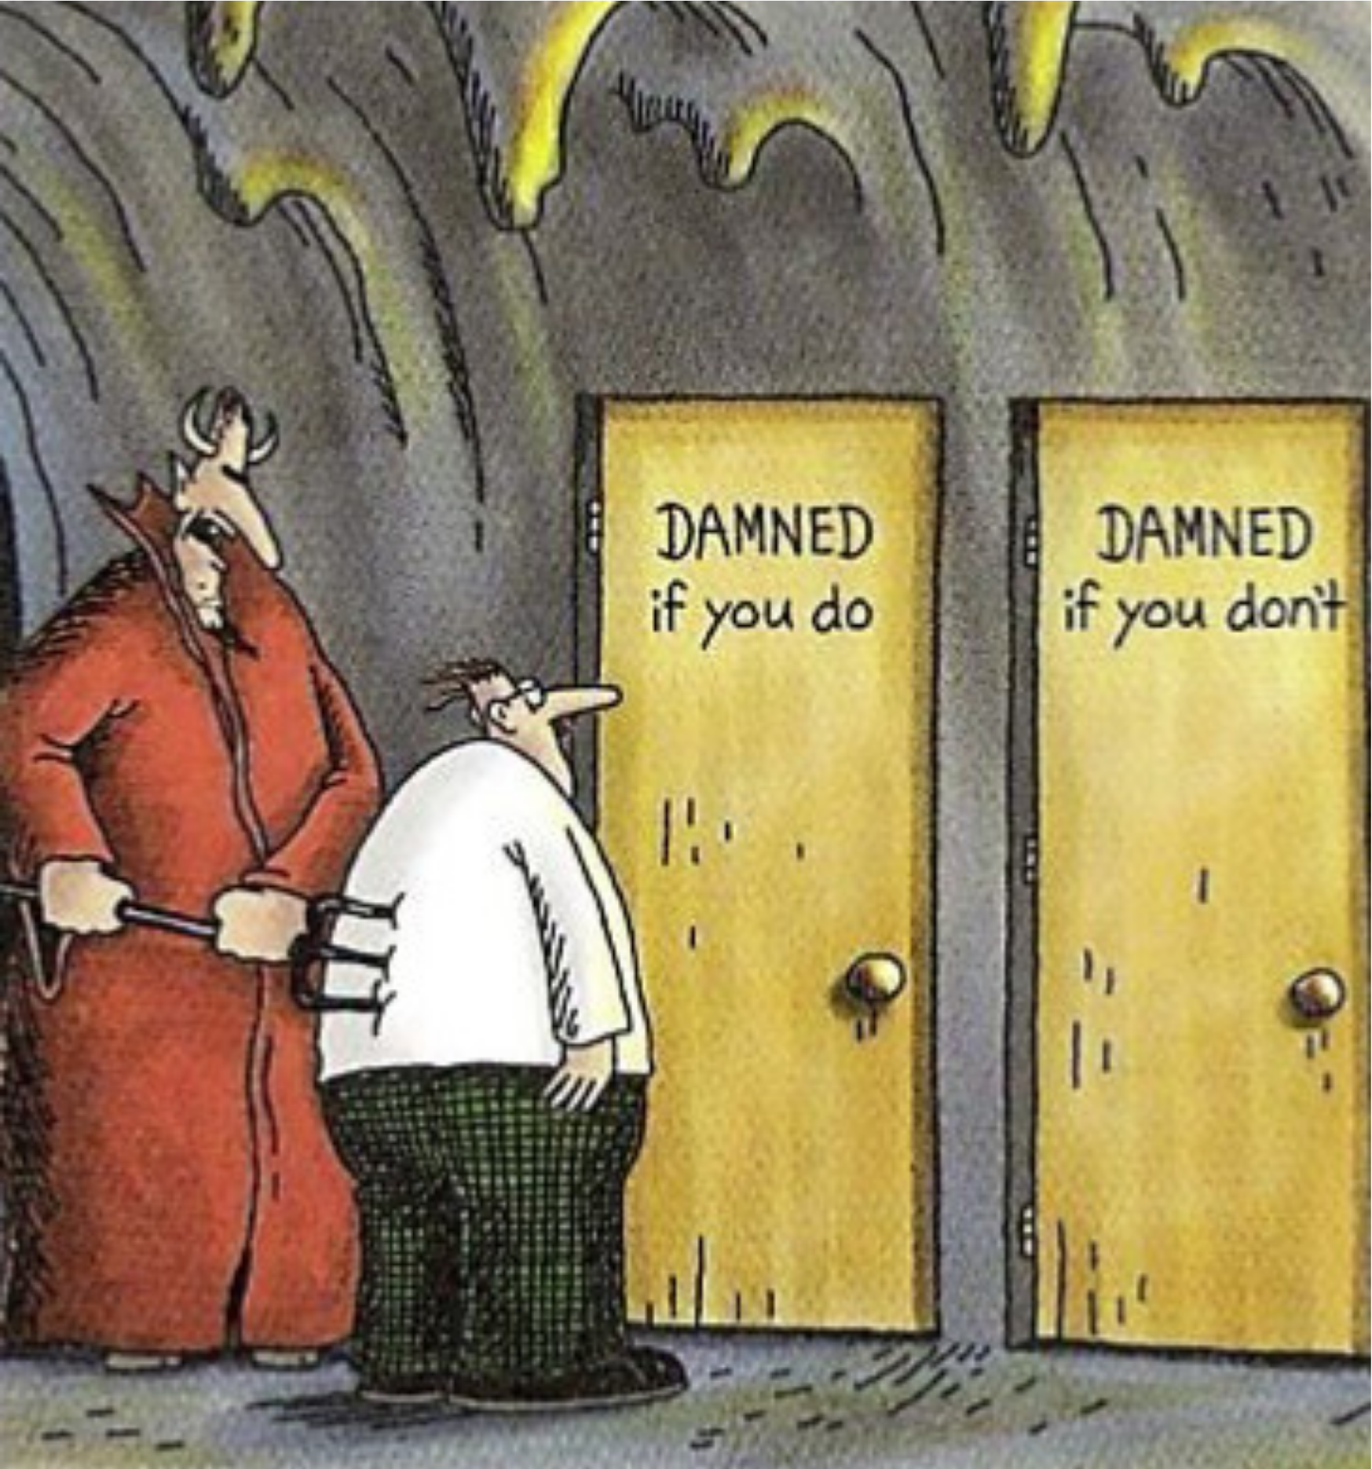
https://bidoonism.com/2019/11/29/damned-if-you-do/

Slide 6
Moral Foundations Test
Access the test
Respond to all 36 questions
Save your results for later
Reflect on your results as you read the explanation
How did you decide on answers - did you think carefully about each question or was it more of a gut feeling?
Were you surprised? Or did the results confirm your expectations?

Slide 7
Let's pause the slides now and go to this module's case study. Upon reading the case, reflect on what is ethical dilemma here? How would you start untangling the issue?

Slide 8
Ethical Decision-Making

Slide 9
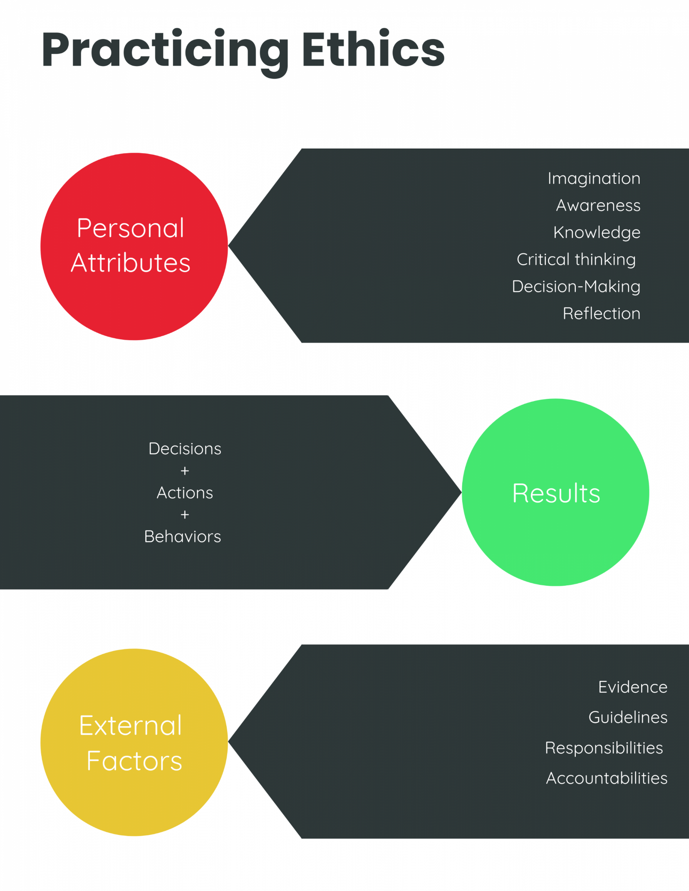

Slide 10
Ethical Decision Making - Finding Better Problems
Reflect on your gut reaction
Where does it come from?
What might you be missing?
Resist immediate solutions
Find the roots of the problem
Ethical problems are not puzzles to be solved but opportunities for creative exploration and contemplation of life and its meanings.
Never only one solution to any particular problem
Resist false dilemmas (only two options)
Open the broadest possible range of solutions
Identify Values
Assume neither side totally right or wrong
Find common values
Middle way: not compromise but higher ground, the apex of a triangle
Weston, A. (1992). Toward better problems: New perspectives on abortion, animal rights, the environment, and justice. (Vol. 21). Temple University Press.

Slide 11
Ethical Reflection
Assist learners in becoming positively socialized into their roles and in forming professional identities,
enable them to process, gain perspective on, and come to terms with difficulties encountered on the road to becoming a professional;
enable learners to become more self-aware and mindful practitioners who are capable of reflection-in-action and reflection-on-action and who are committed to their professional and ethical values.
Tool to develop a respect of the concerns of others
Necessary to promote maturity in ethical thinking
Guided discussions with trained ethics facilitator
During and after the case
Professional formation

Slide 12
At the end of the module, spend couple of minutes to consider how you approach challenging ethics issues at your workplace?

Slide 13
NEXT STEPS
If you want to learn more about the topics presented in this module, here are some suggestions :
Branch Jr, W. T., & George, M. (2017). Reflection-based learning for professional ethical formation. AMA Journal of Ethics, 19(4), 349-356.

