Slide 1

Ethical Care of Uninsured Patients: Balancing Patient Need and Organizational Stewardship
Winifred Badaiki, Clinical and Organizational Ethicist
Sun Drews, Ethics Fellow
Hamilton Health Sciences

Slide 2



Slide 3
Webinar Housekeeping
Everyone will be muted except the host, moderator and panelists
Ask questions through the Teams chat box
All webinars will be recorded and posted on the internal PEaCE Hub page and on the Regional Ethics Network Website
Please take a moment to scan the QR code to complete the evaluation
Next month’s speaker

Slide 4


Slide 5
Objectives
Understand the ethical principles and tensions involved in responding to requests for non-emergent care for uninsured patents.
Appreciate how organizational protocols help staff balance moral obligations to patients with competing operational and financial interests.
Describe steps in navigating requests for non-emergent care from uninsured patients.

Slide 6
This Presentation Will not Cover
Broader debates concerning Ontario and/or Canada’s overall approach to providing care for uninsured patients
Global justice questions or international policy issues related to healthcare access

Slide 7


What is the Scenario?

Slide 8
Context & Background
Hamilton, Ontario proximity to the U.S. border and Pearson International Airport
Hamilton Health Sciences (HHS) is a regional healthcare center which services the city of Hamilton as well as surrounding region
Record high immigration levels
Global pandemic
Increased wait times for medical treatment
Changes to healthcare organization funding structures
Changes to Canadian policy impacting immigrant groups – e.g., international students

Slide 9

Protocol Scope
Defining “Uninsured”: Applies to patients who do not meet eligibility criteria for Ontario Health Insurance Plan (OHIP) and lack third-party insurance coverage.
Insufficient Coverage: Includes non-OHIP patients with private insurance that is inadequate for the specific treatment required.
Out of Scope
Insured Services: This protocol does not apply to patients with valid OHIP coverage.
Excluded Services: Does not address the provision of “uninsured services” for patients with valid OHIP coverage.

Slide 10
Who is Uninsured: OHIP Eligibility
To qualify for OHIP, one must meet these minimum qualifications:
Be physically in Ontario for 153 days in any 12‑month period
Make Ontario one’s primary residence
One must also meet at least 1 of the following additional requirements:
Be a Canadian Citizen/ Indigenous Person/ Permanent Resident
Have applied for permanent residence in Canada and received confirmation of application
Be in Ontario on a valid work permit and are working full-time in Ontario, for an Ontario employer
Have a Temporary Resident Permit
Be a clergy member who can legally stay in Canada and will be ministering full time in Ontario for at least 6 months
Be a convention refugee or other protected person as defined by Immigration and Refugee Board of Canada

Slide 11

What is the Ethical Issue?
COMPETING
INTERESTS
Patient Needs
Professional Obligations
Duty to care
Organizational Interests and
Limiting uncompensated care costs, strain on limited staff and clinical resources
Duty to provide benefit and reduce harm
Fair prioritization of care
Needs

Slide 12
Case Example
Paula is a 55-year-old woman who is in Canada on a study visa.
Medical history: She was brought to the ED after various episodes of severe dizziness. She was immediately revived and she is now stable. Further investigation revealed that she has colon cancer with regional spread.
Social History: She lives with her daughter with whom she is on a lease, and she helps with childcare and has been visiting Canada on and off for the past 12 years until she decided to get her PhD two years ago. 2 of her children live in Canada and the other two in her home country. Her spouse passed ten years ago. She has a lot of friends and extended family in Canada. She volunteers in the soup kitchen of the local church that she attends.
Paula's daughter Janice would like for her mum to continue to receive care here at Hamilton Health Sciences. Her reasons include:
  She, her other siblings, family and friends can continue to care for her mum here
  Care needed is not available in their home country or if available, is not accessible as would be in Canada
  They believe care in Canada is free and they will pay heavily for cancer care in home country

Slide 13

Previous Decision-Making Process & Criteria
If care is urgent, HHS will provide care as needed.
If care required is non-urgent, the following humanitarian criteria must be met:
Medical inability to return to home country
MRP judges that required care is not reasonably available in patients’ home country
The patient has close connection to Canada
If patient meets above criteria, the Uninsured Patient Decision Panel (UPDP) will be convened to determine if care can and should be provided, based on criteria:
Medical need of patient
Organizational Stewardship
Availability or access to treatment in country of origin

Slide 14
Why did we need to revisit the old protocol?
Did Not Address Payment
Lack of Standard Procedure
Lack of Role Clarity
Vague Decision-Making Process

Slide 15
Revising the Protocol: Key Objectives
Establish a Clear Response Protocol: Standardize the process for evaluating and responding to requests for non-emergent uninsured care.
Formalize Decision-Making Criteria: Define a structured, transparent framework to ensure clinical and administrative decisions are consistent across the organization.
Prioritize Quality Improvement: Identify systemic challenges to inform further review and service improvement.

Slide 16
Revising the Protocol: Key Considerations
Ability to pay
Definition of community member
Logistics
Financial Impact

Slide 17
Revising the Protocol: Ethical Principles
STEWARDSHIP: Every service provided must be paid for, and the organization is obligated to manage finite resources responsibly.
TRANSPARENCY: Decisions must be consistent and clearly communicated.
PUBLIC HEALTH & SAFETY: Communicable diseases may impose additional duties to treat.
JUSTICE & EQUITY: Ensuring fairness, recognizing risks of bias, and promoting procedural equity.
HUMANITARIANISM: Emergency care will never be denied based on ability to pay.

Slide 18
Applying the Revised Protocol to Paula’s Case

Slide 19
Revised Protocol: Decision-Making Process
Steps | Case Example | Updated Decision-Making Procedure
Step 1a: Patient presents to HHS through the Emergency Department for urgent care | Paula was seen in ED for dizzy spells. She will be expected to pay for her care in the ED | Emergent care will be provided based on medical need. Patients who received uninsured emergent treatment will be contacted by HHS Finance to arrange payment plan.
Step 1b: Patient presents to HHS through the Emergency Department or is referred for non-urgent care | Paula’s ED admission revealed colon cancer ED team has referred her for follow-up care at HHS | Most Responsible Physician (MRP) will contact relevant team leadership and assess program and hospital capacity. Considerations of capacity include: Current hospital resources, human resources and bed/clinic capacity to provide care Impact on the organization’s ability within the current context to meet the needs of OHIP patients

Slide 20
Steps | Case Example | Updated Decision-Making Procedure
Step 2: If criteria in step 1b is met | What does this look like for Paula? | Consider: Is there a physician willing to act as MRP (given uncertainty of reimbursement)? Is the patient medically unable to return to their country of origin (i.e., person too sick to travel)? Or is care not reasonably available in country of origin? Is the patient unable to be referred to another hospital or care provider? Does the patient have a close connection to this community (as defined by CMPA or indigenous treaty rights)? If above requirements are met, a proposed care plan will be developed by the MRP.

Slide 21
Steps | Case Example | Updated Decision-Making Procedure
Step 3: Finance/Leadership meet with team to discuss resources. Finance/Social Work meet with patient/ family to discuss ability to pay. | What does this look like for Paula? | If patient can pay → program to decide if care can be coordinated If patient cannot pay (for all or some of care) → Uninsured Patient Decision Panel (UPDP) is convened by program leadership to determine whether care be coordinated using the UPDP Decision-Making Framework.

Slide 22
Revised Protocol: UPDP Decision-Making Framework
New Decision-Making Framework
Medical benefit to patient (Expected benefit/harms of treatment based on best available evidence)
Patient Ability to pay minimal amount within a certain time period
Financial impact to program and organization (Impact on the program/ organization to meet its budget targets and/or provide appropriate care/services)
Availability of/access to similar treatment elsewhere (Care that meets patient’s medical need is available elsewhere, e.g. in community hospital, clinic, or country of origin (if applicable)).
Close Connection to Hamilton Community (Patient connection to the local community)

Slide 23
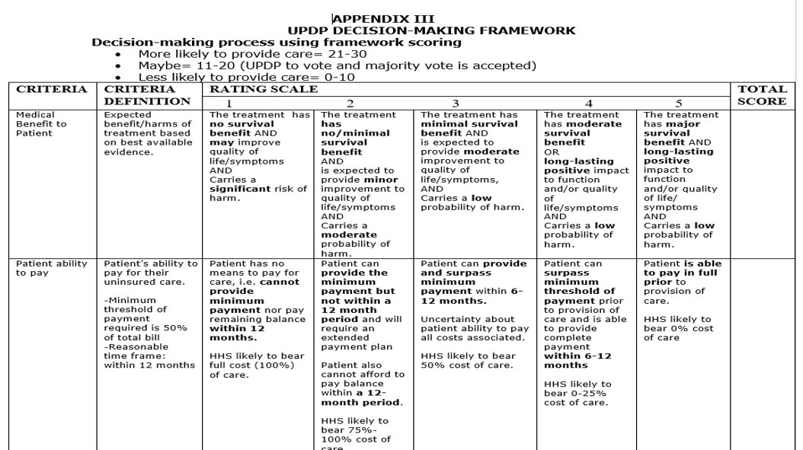
Revised Protocol: UPDP Decision-Making Framework

Slide 24
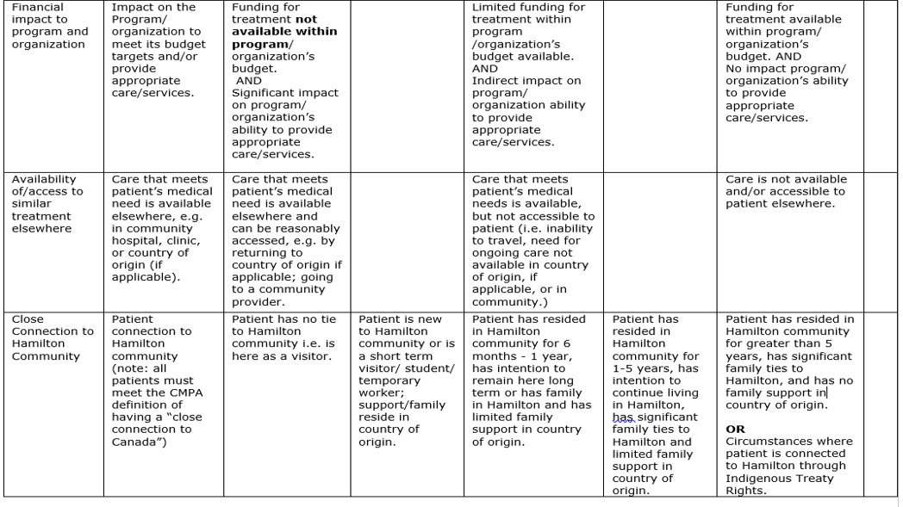

Slide 25
Steps | Case Example | Updated Decision-Making Procedure
Step 4: Communicate cost of treatment plan to patient/family | What does this mean for Paula? | Finance will advise the patient/family of costs related to uninsured services to be provided and will arrange to collect appropriate payment prior to provision of treatment/services.

Slide 26
Reviewing the Case: Ethical Principles
STEWARDSHIP: Clinical leadership determined if HHS has the resources to support Paula’s cancer care and how that might impact other Ontario patients who are waiting for care.
TRANSPARENCY: Paula was informed of the cost of her care and how decisions were being made about her ongoing care.
JUSTICE & EQUITY: Decisions about Paula’s ongoing cancer care followed the same fair process and consistent criteria used for all uninsured patients seeking non-emergent care.
HUMANITARIANISM: Emergency care was provided to Paula regardless of her ability to pay.
Notes:
Principle/ethics re Paula case
How each principle applies…name the ethical tensions

Slide 27
Conclusion
A protocol to address requests for non-urgent care by uninsured patients requires a multidisciplinary approach grounded in ethical principles, thoughtfully balancing obligations to uninsured patients, staff, the organization, and the broader community.
Establishing a clear and transparent process fosters trust and accountability, ensuring that everyone involved in providing care to uninsured patients understands their roles and responsibilities.

Slide 28

LET’S DISCUSS

